Slide 1
Evaluating Causal Discovery Algorithms For Undersampled Time Series
John Cook

Slide 2
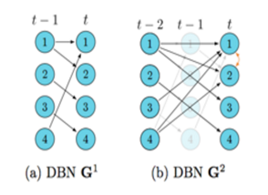
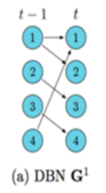
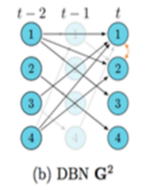
The Problem
Researchers assume measurement timescale is equal to causal timescale.
Discrepancy between these timescales can drastically affect causal structure.
Causal Timescale
Measurement Timescale

Slide 3
Causal Timescale
Measurement Timescale
Note the difference in Graph Structure
The G² graph contains many different relationships than the G¹ graph
Undersample rate(urate) of 2

Slide 4
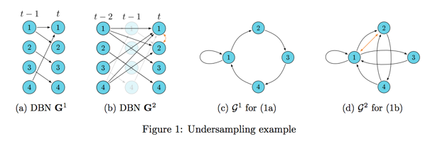
Causal Timescale
Measurement Timescale
Causal Timescale
Measurement Timescale
David Danks, Sergey Plis. Learning Causal Structure from Undersampled Time Series. 2013

Slide 5
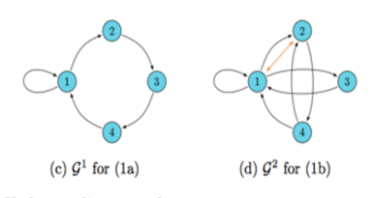
Importance
Some researchers wrongly assume measurement timescale = causal timescale causing incorrect causal relations to be reported
Other researchers understand their causal timescale but cannot estimate it due to insufficient instruments or lack of data
Can provide alternative theories when true causal timescale is not known

Slide 6
Where Undersampling Occurs
fMRI experiments
typically measure brain activity every two seconds
causal connections between neuron layers operate much faster
Economics
Data is often reported annually
Even more infrequent for developing countries
Ecology, Climatology, genomics, etc.
Sergey Plis, David Danks, Jianyu Yang. Mesochronal Structure Learning. 2015
S. A. Huettel, A. W. Song, and G. McCarthy. Functional magnetic resonance imaging. 2004.

Slide 7
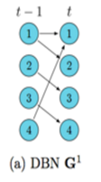
Notation and Assumptions
Assumptions:
First-Order Markov
No isochronal edges in G
Notation:
Graph Size
Density
Undersampling Rate, G^{u}
Variable Arity = Number of possible variable states
Binary Variable has an arity of 2
Ternary Variable has an arity of 3

Slide 8
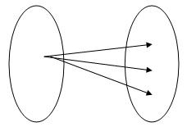
Previous Work
Can obtain correct G¹ graph (causal timescale) given G^{u} graph (measurement timescale) assuming field expertise
G^{u} Space G¹ Space

Slide 9
Questions To Answer
Which estimation methods work best?
How accurate are our G^{u} estimation methods?
(And in what cases will they work?)

Slide 10
Methods Tested
Continuous Data
SVAR
PC Algorithm
Greedy Equivalence Search
Granger Causality
Discrete Data
PC Algorithm
Globally Optimal Bayesian Network learning using Integer Linear Programming(GOBNILP)

Slide 11
How the Models are Tested
Omission Error
Commission Error
Total Error

Slide 12
Continuous Data Case
(The Highlights)

Slide 13
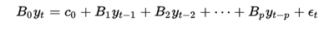
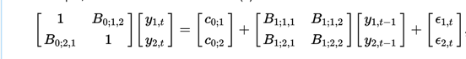
Structural Vector AutoRegressive Model(SVAR)
SVAR Model:
Two Variable SVAR of lag 1:
https://en.wikipedia.org/wiki/Vector_autoregression#Structural_vs._reduced_form

Slide 14
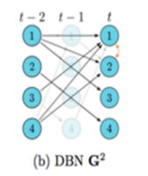
PC Algorithm(PC)
Tests each edge for independence using OLS for each parent set

Slide 15
Greedy Equivalence Search(FGS)
Uses local scoring(BIC or BDeu) to rank possible edges
Performs edge addition then edge deletion to find best scoring graph

Slide 16
Granger Causality(GC)
For a given edge X_{i} -> Y, Generate 2 models:
Model 1: X₁,...X_{i-1},X_{i+1},...,X_{n} -> Y
Model 2: X₁,...,X_{n} -> Y
If Model 2 is a better predictor of Y than Model 1, we say:
X_{i} granger causes Y

Slide 17
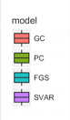
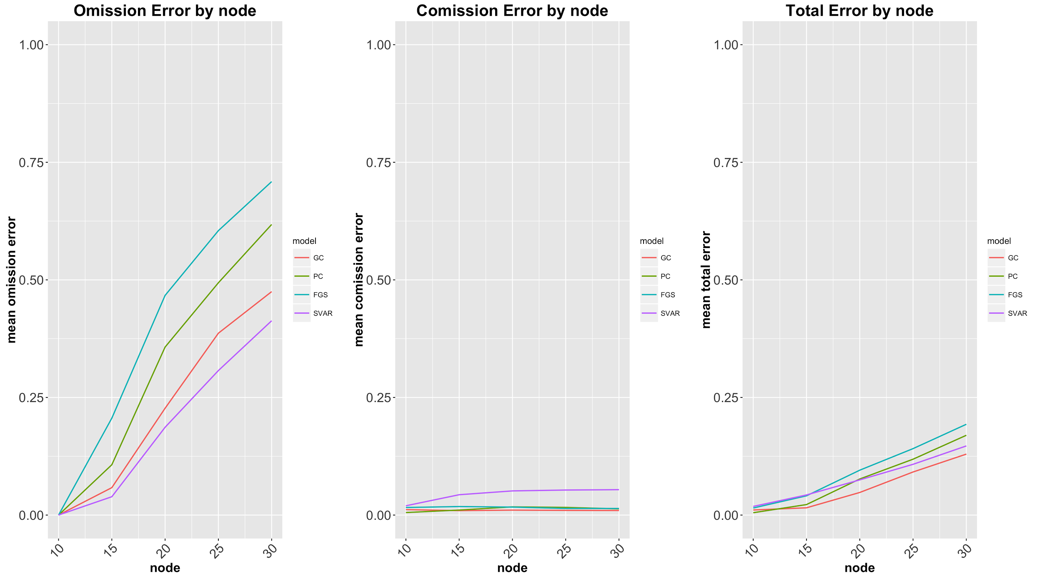
Graph Size
Omission error increases with graph size
Commission Error stays low
SVAR and GC the best
10,15,20,25,30 node 10% graph
Notes:
500 Sample Size

Slide 18
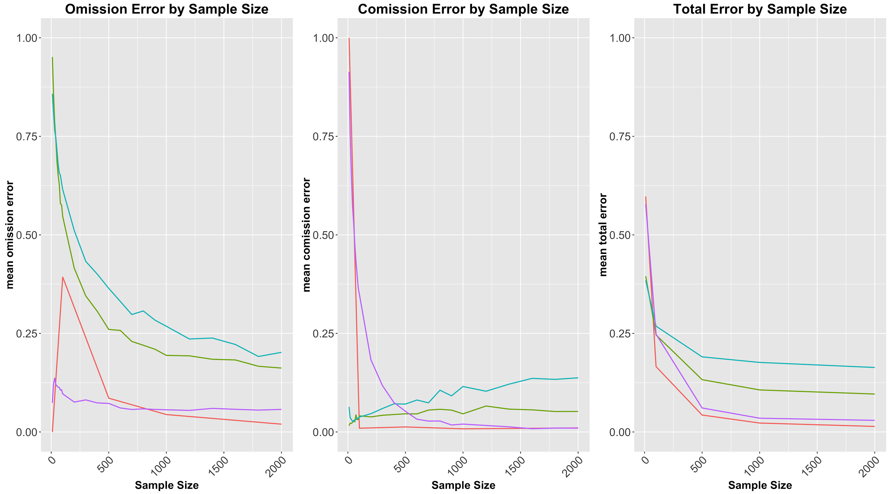
Sample Size
Very accurate with sample size > 500
SVAR and GC the best

Slide 19
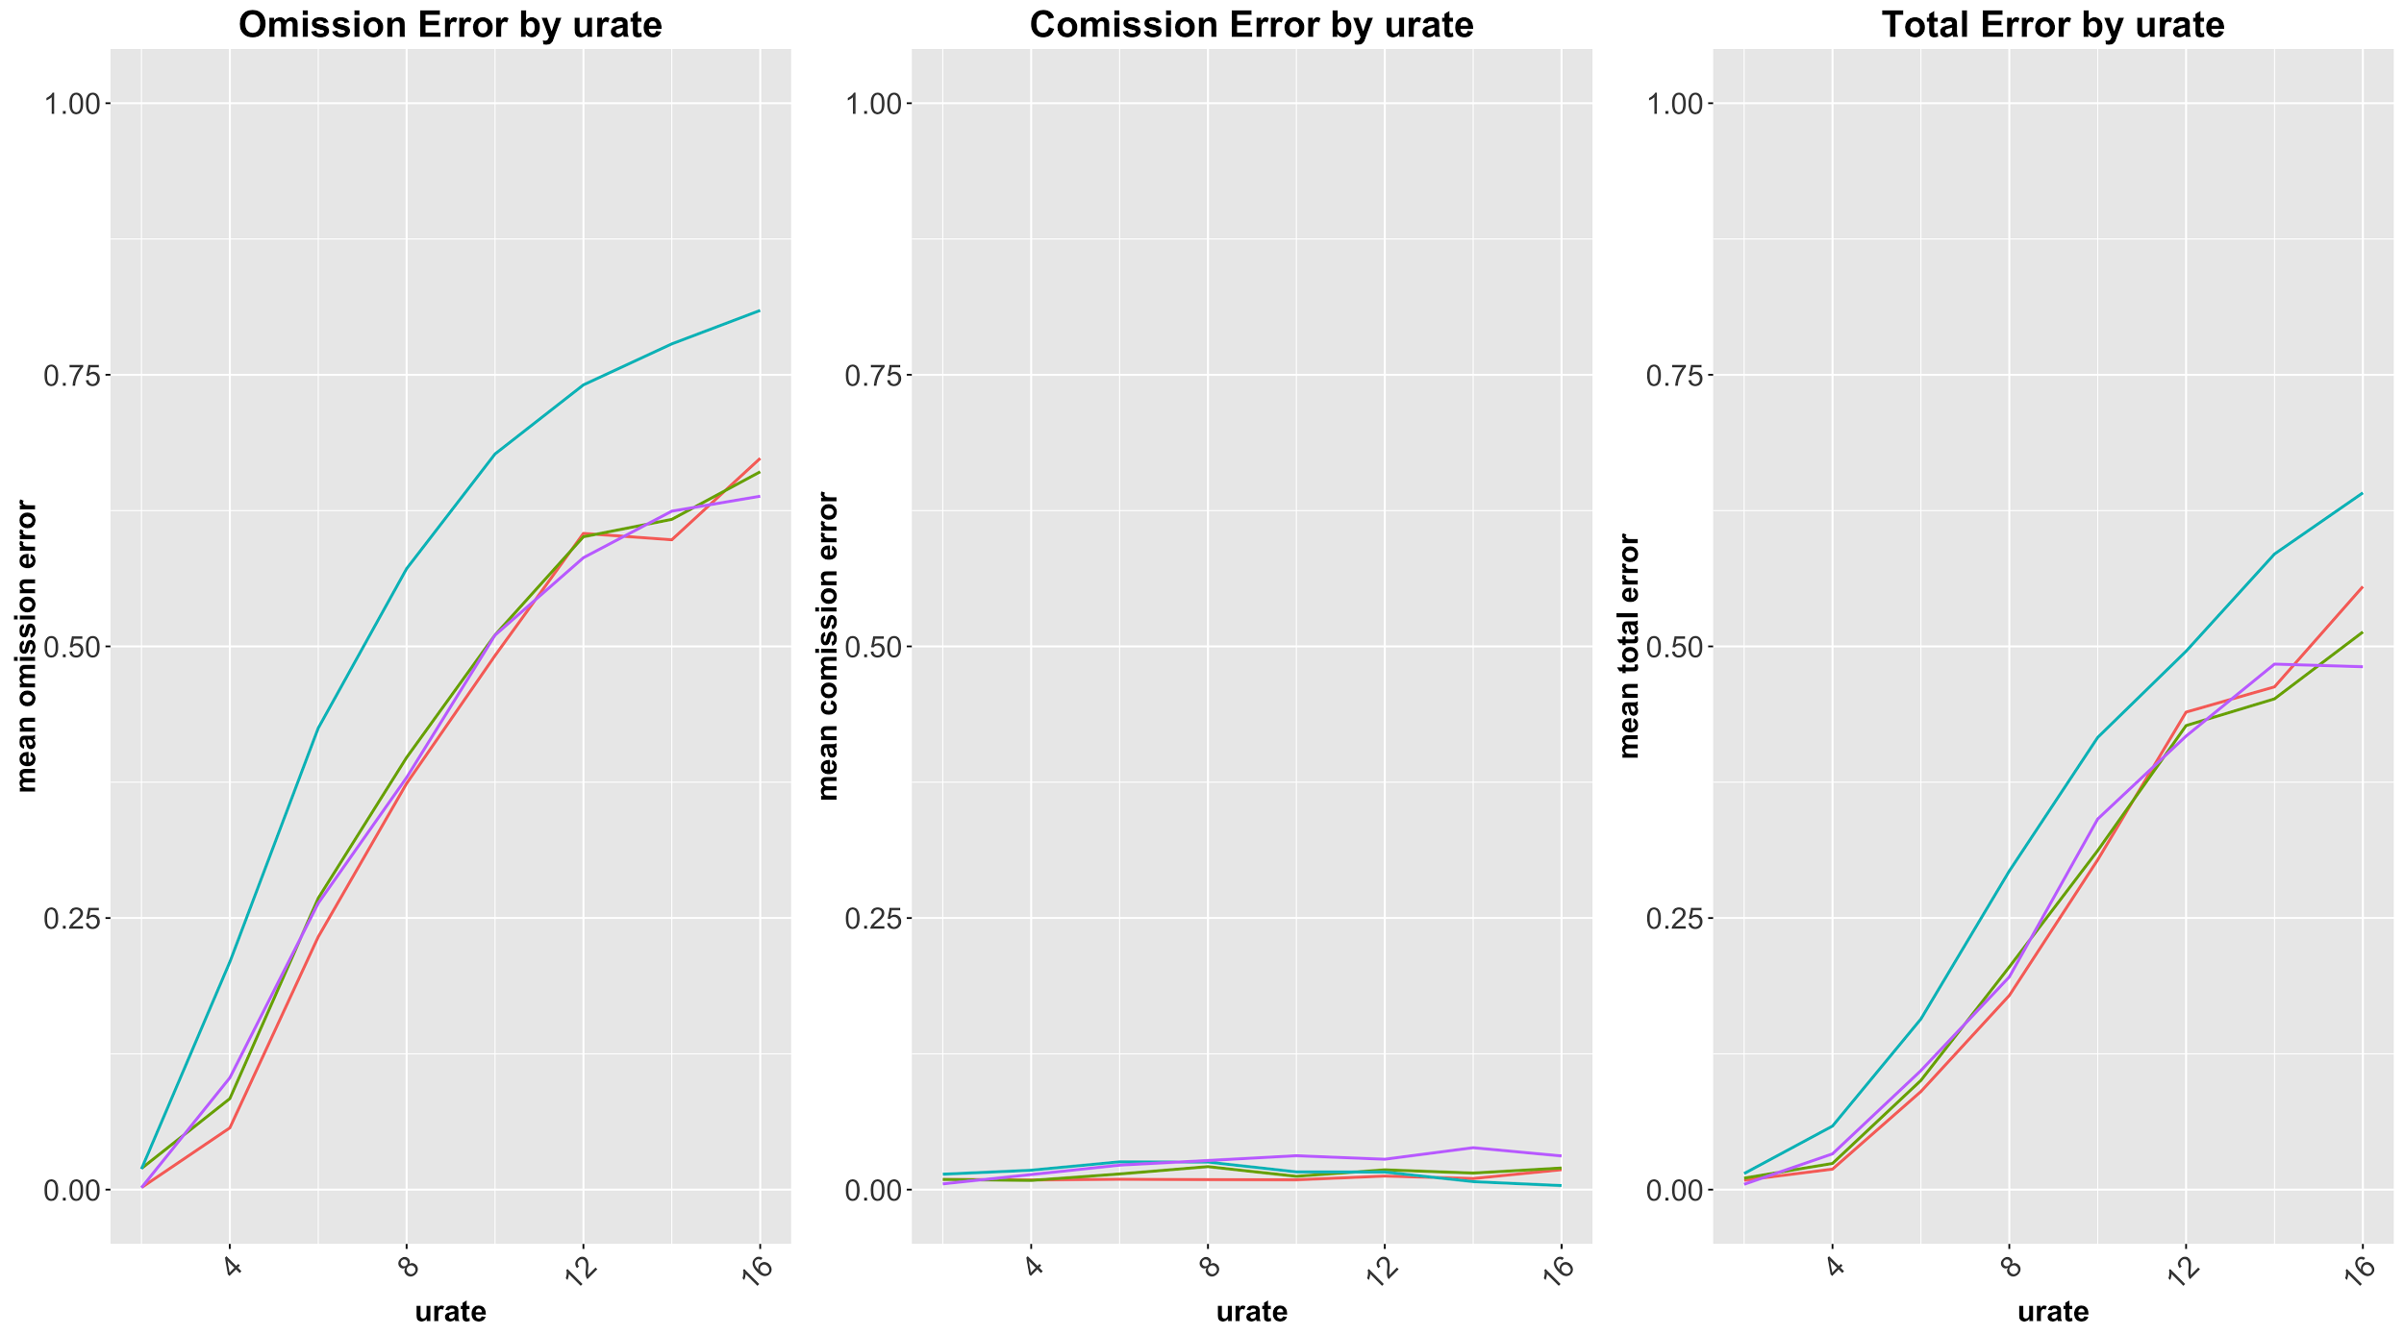
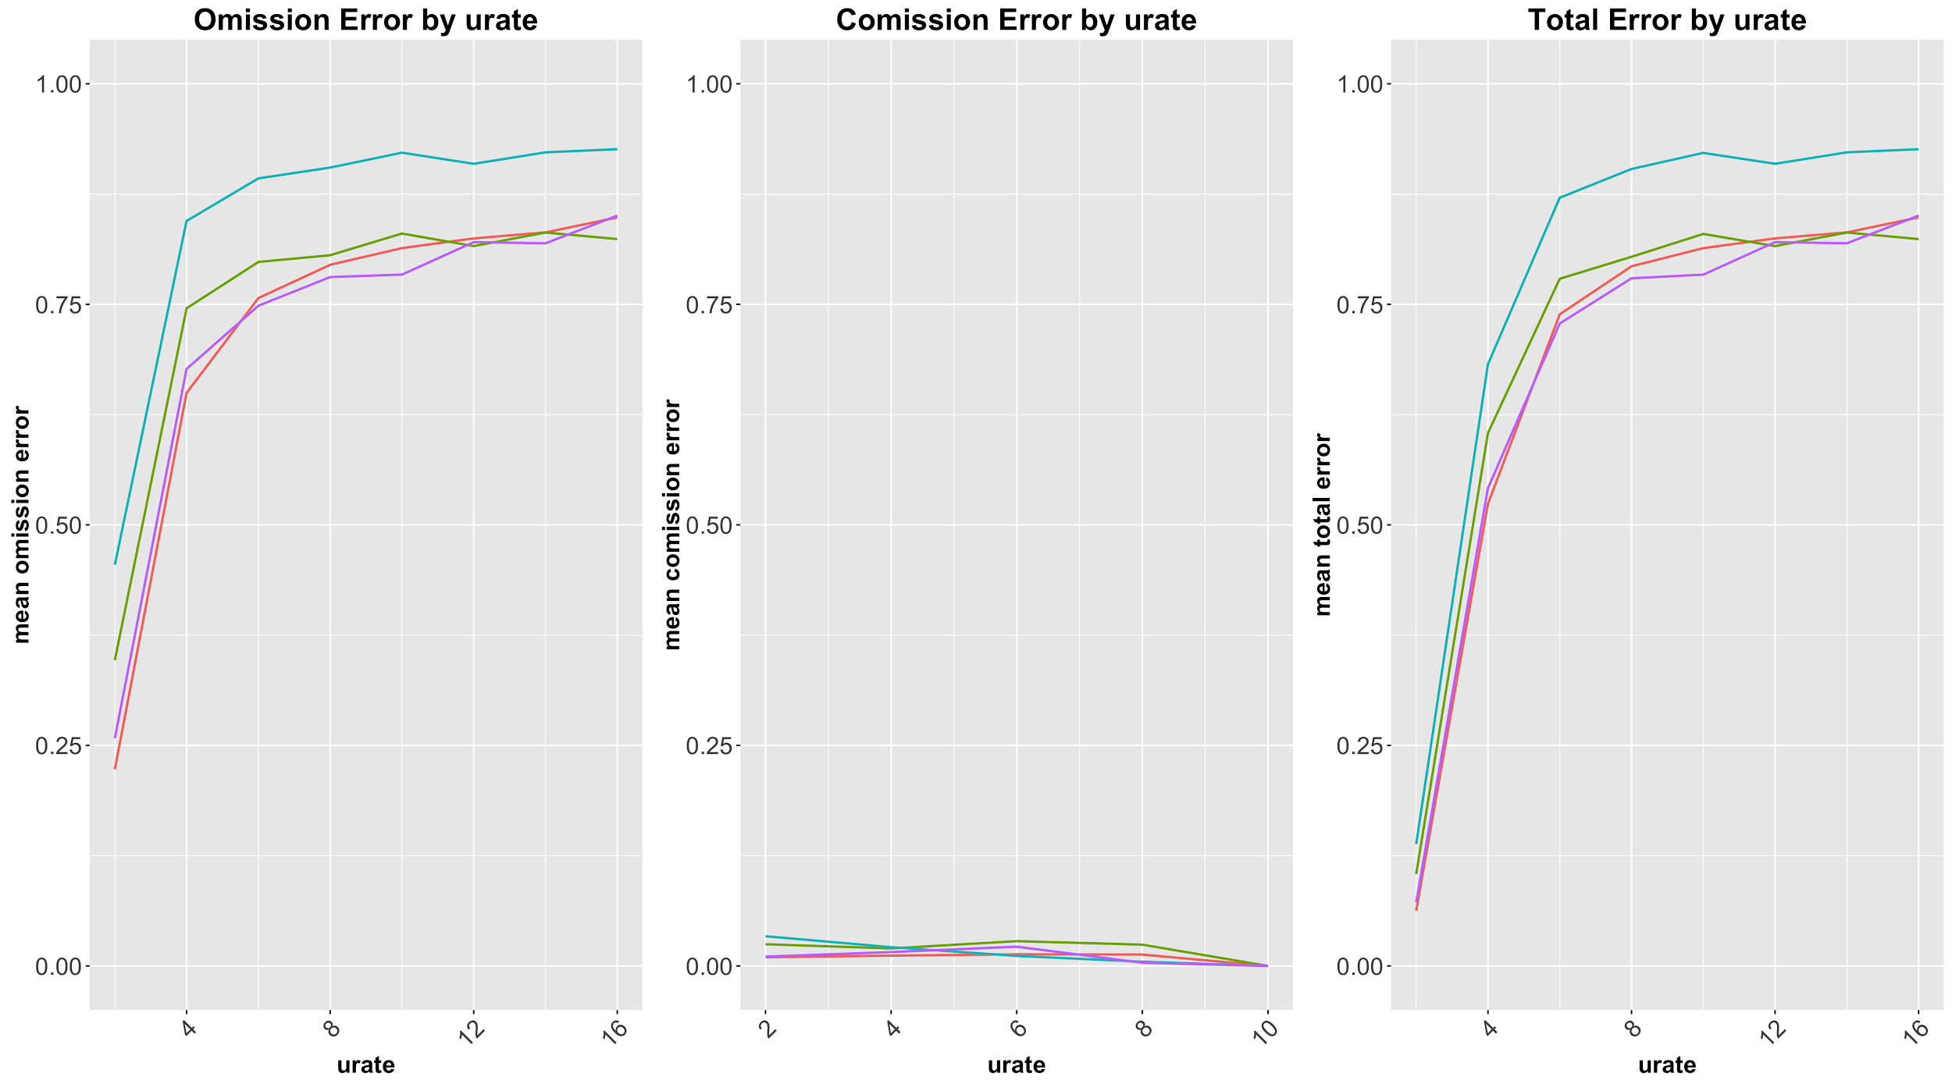
Undersampled Rate
Hoped for a given density, total error is similar across all graph size
10 Node 12% Density 20 Node 12% Density

Slide 20
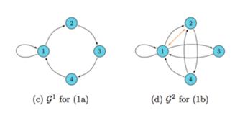
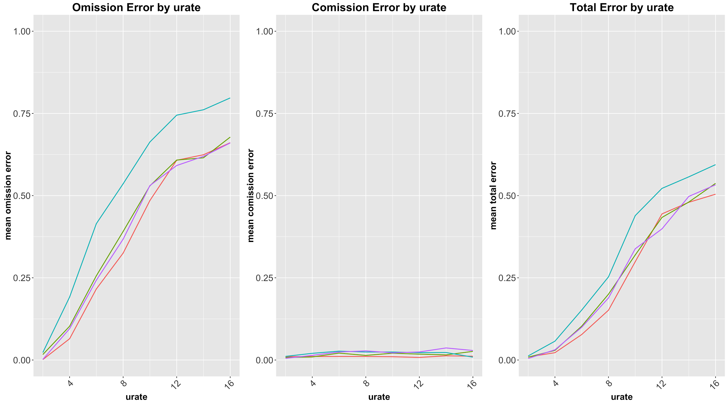
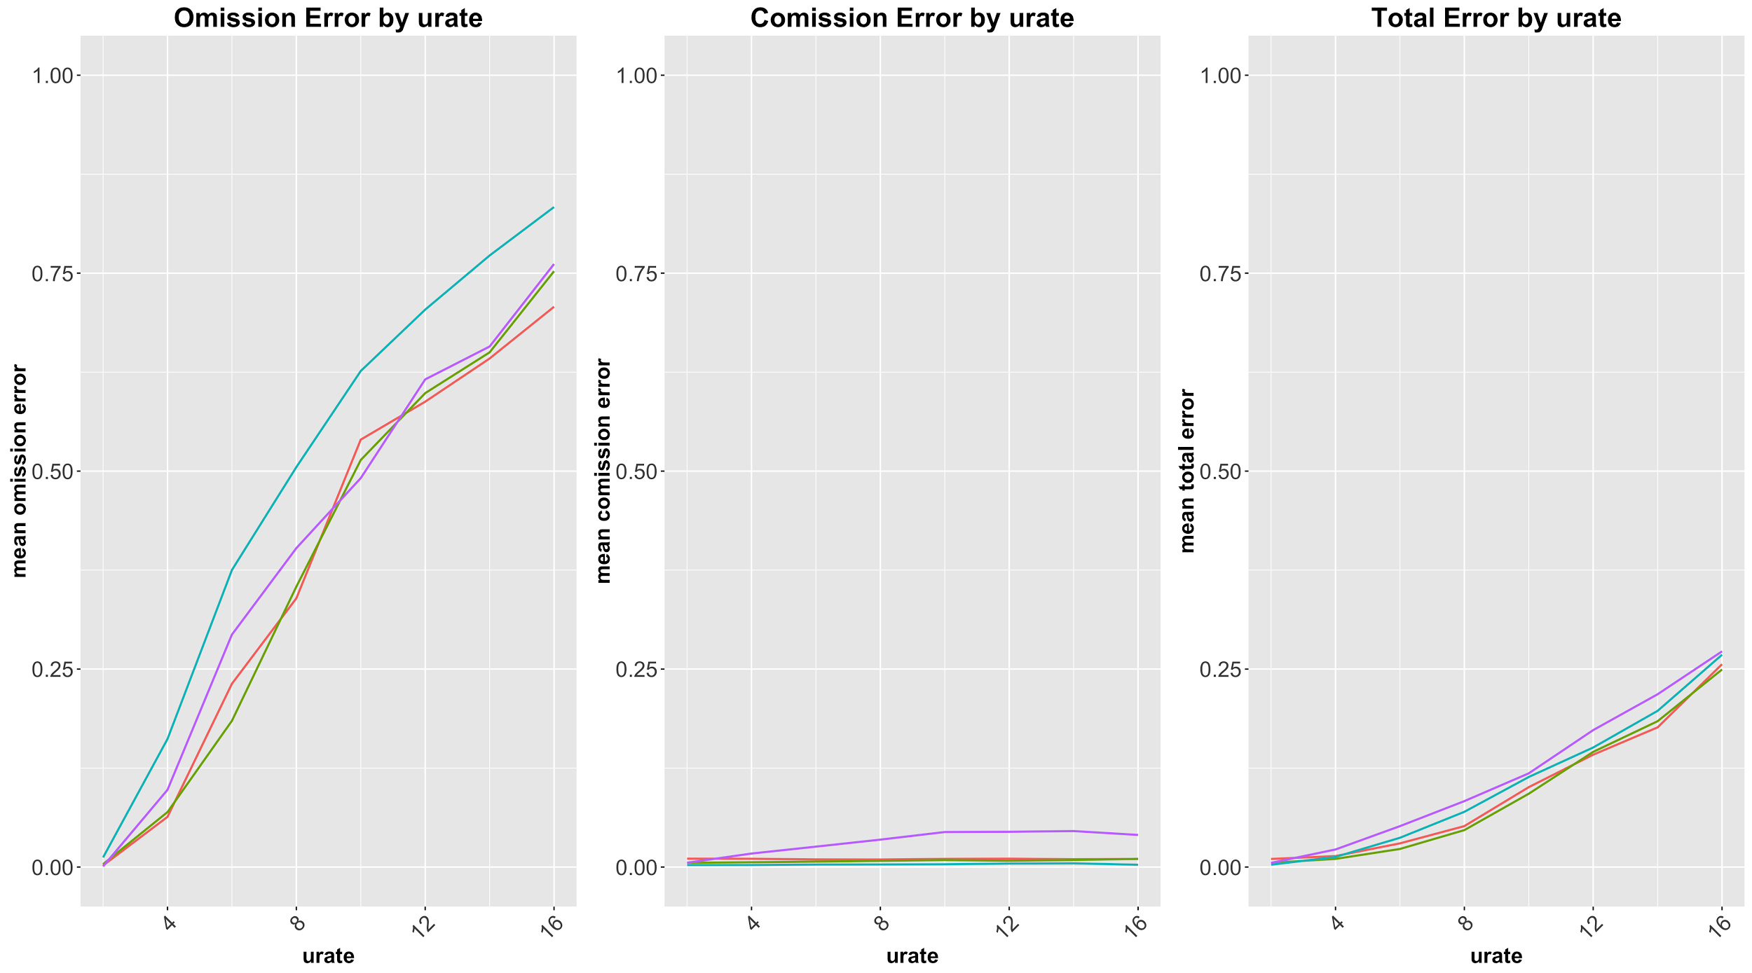
Undersampled Rate (Continued)
Error is more consistent across graph sizes for a given number of “extra edges” than for a given density
10 Node 2 “extra edges” 20 Node 2 “extra edges”
10 Node 2 “extra edges” 20 Node 2 “extra edges”

Slide 21
Discrete Data Case
(The Highlights)

Slide 22
GOBNILP
C program which learns Bayesian Networks from discrete data
Searches for the Bayesian Network with the highest BDeu Score (log marginal likelihood)
GOBNILP manual https://www.cs.york.ac.uk/aig/sw/gobnilp/

Slide 23
Discrete PC Algorithm(DPC)
Tests for conditional independence using conditional 𝝌² -test
Conditional 𝝌² -test
Sum 𝝌² and degrees of freedom for each combination of conditional variable values.
Then calculate p-value of the summed 𝝌² and degrees of freedom

Slide 24
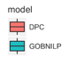
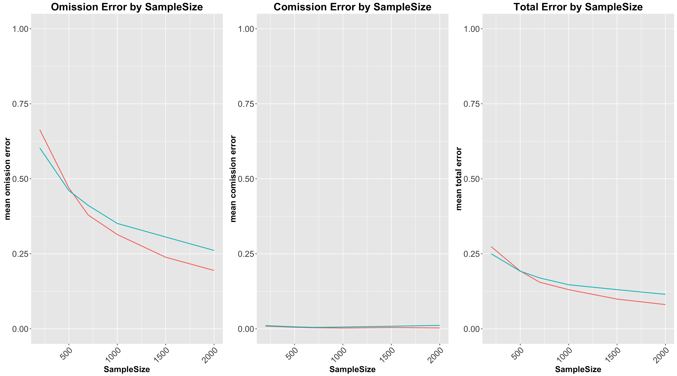
Sample Size For Arity=2
Greater error than continuous case
Need at least 1000 sample size
8 node graph
25% density
2 undersampled rate

Slide 25
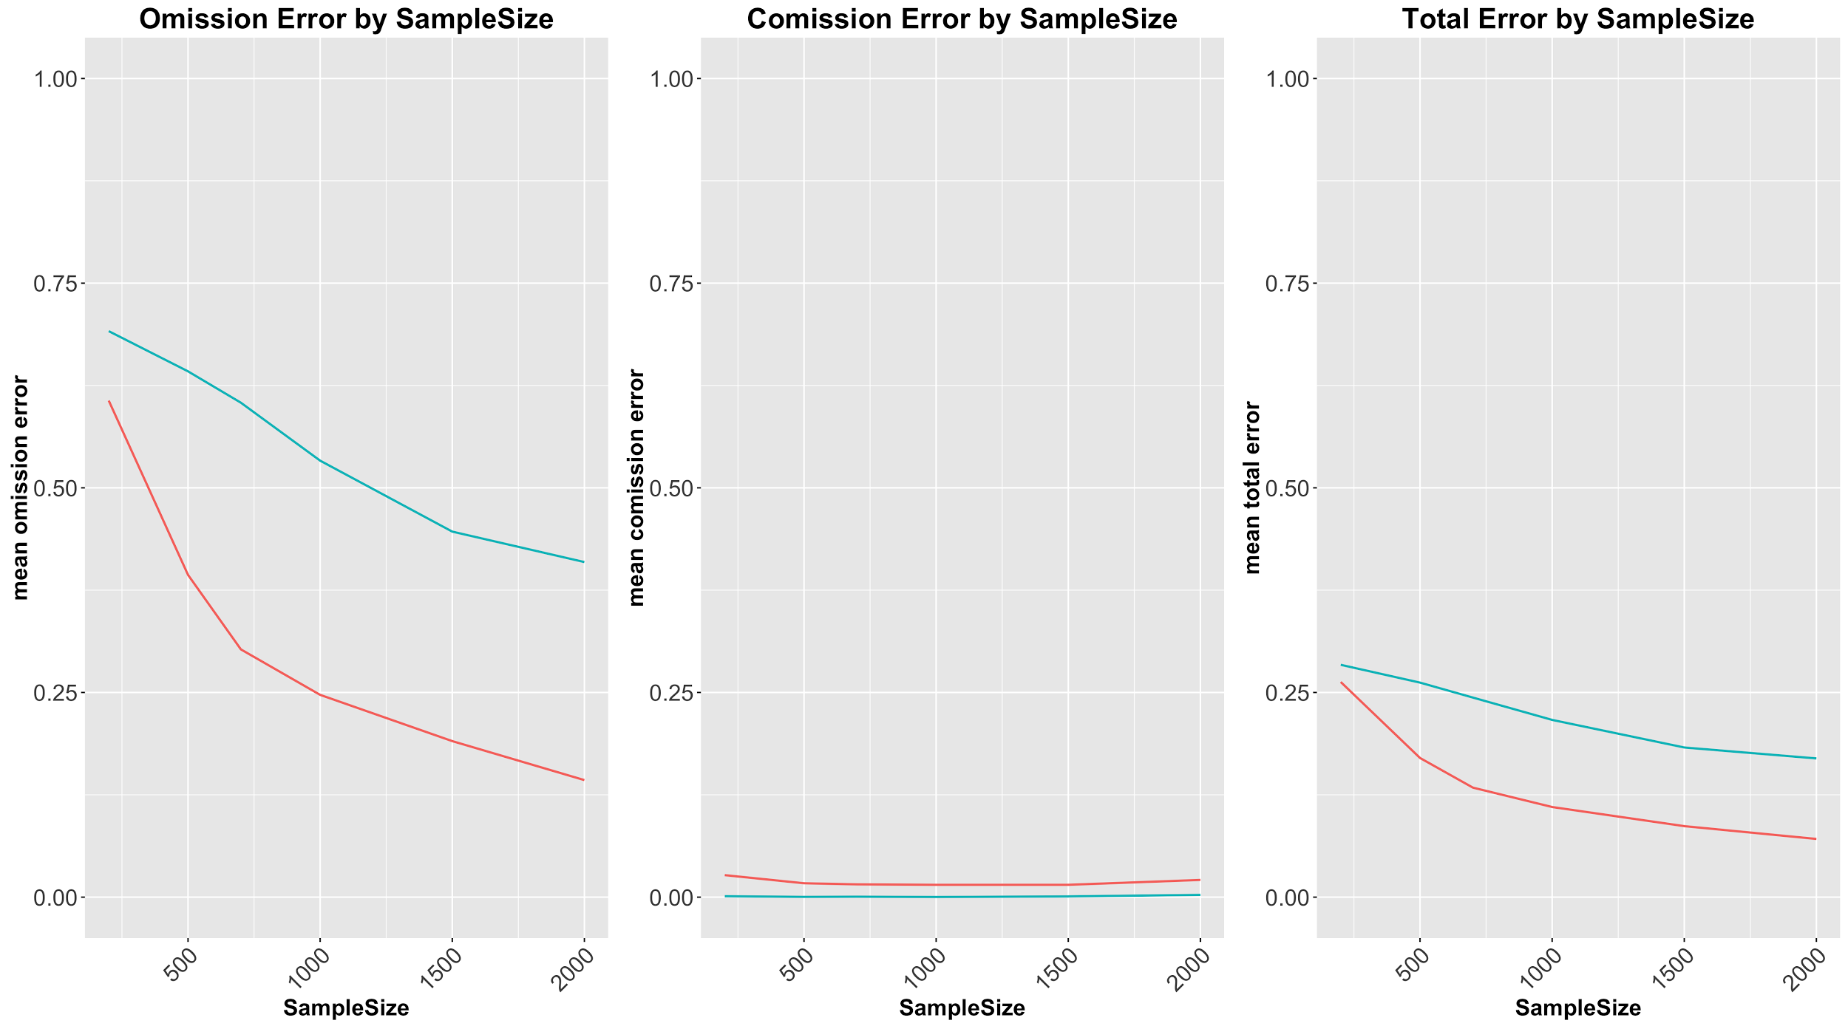
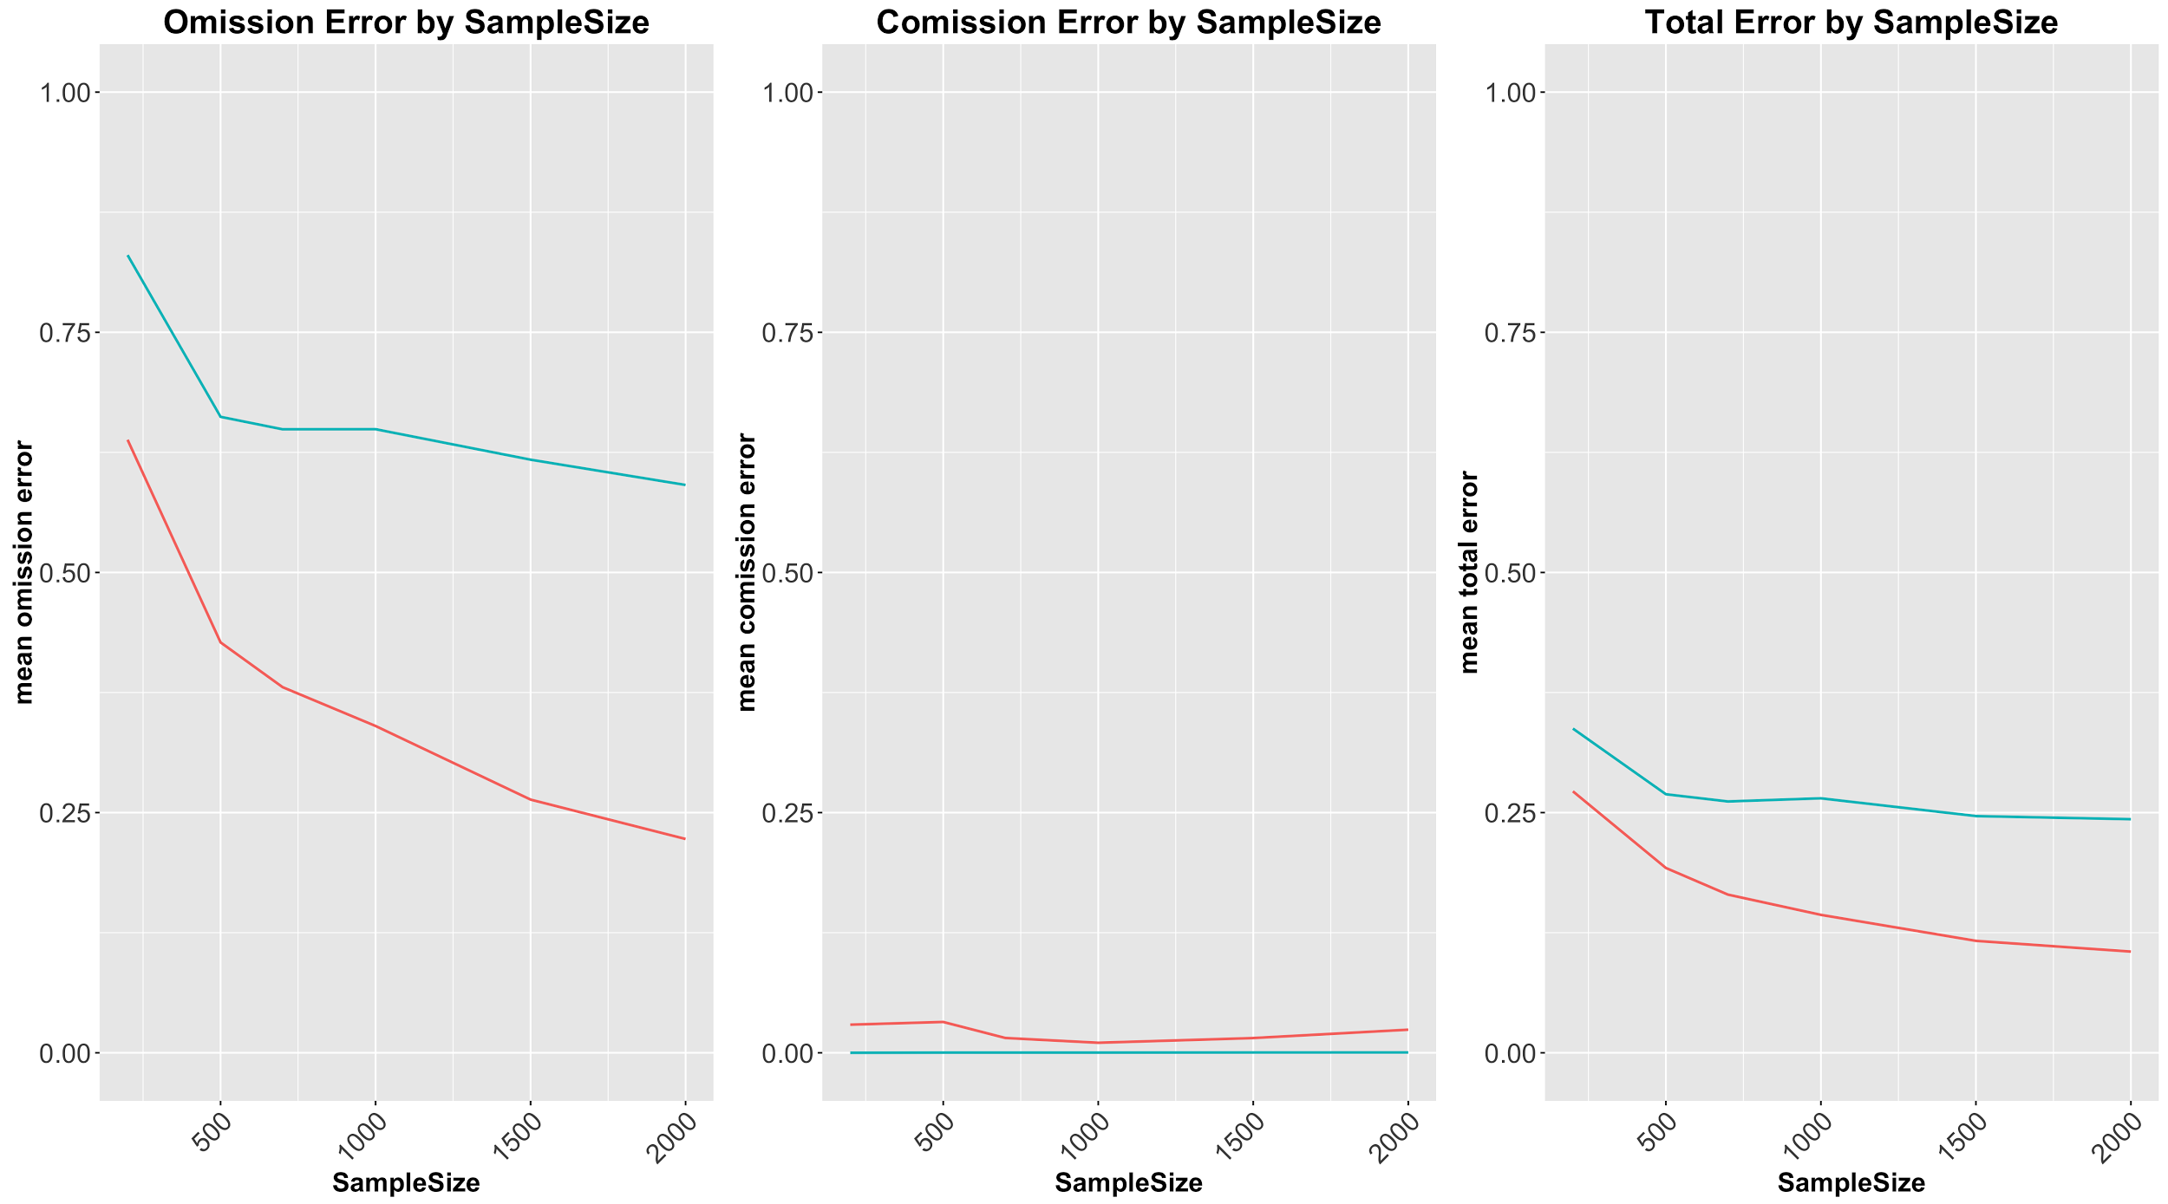
Sample Size Omission Error
Arity=2 Arity=3 Arity=4

Slide 26
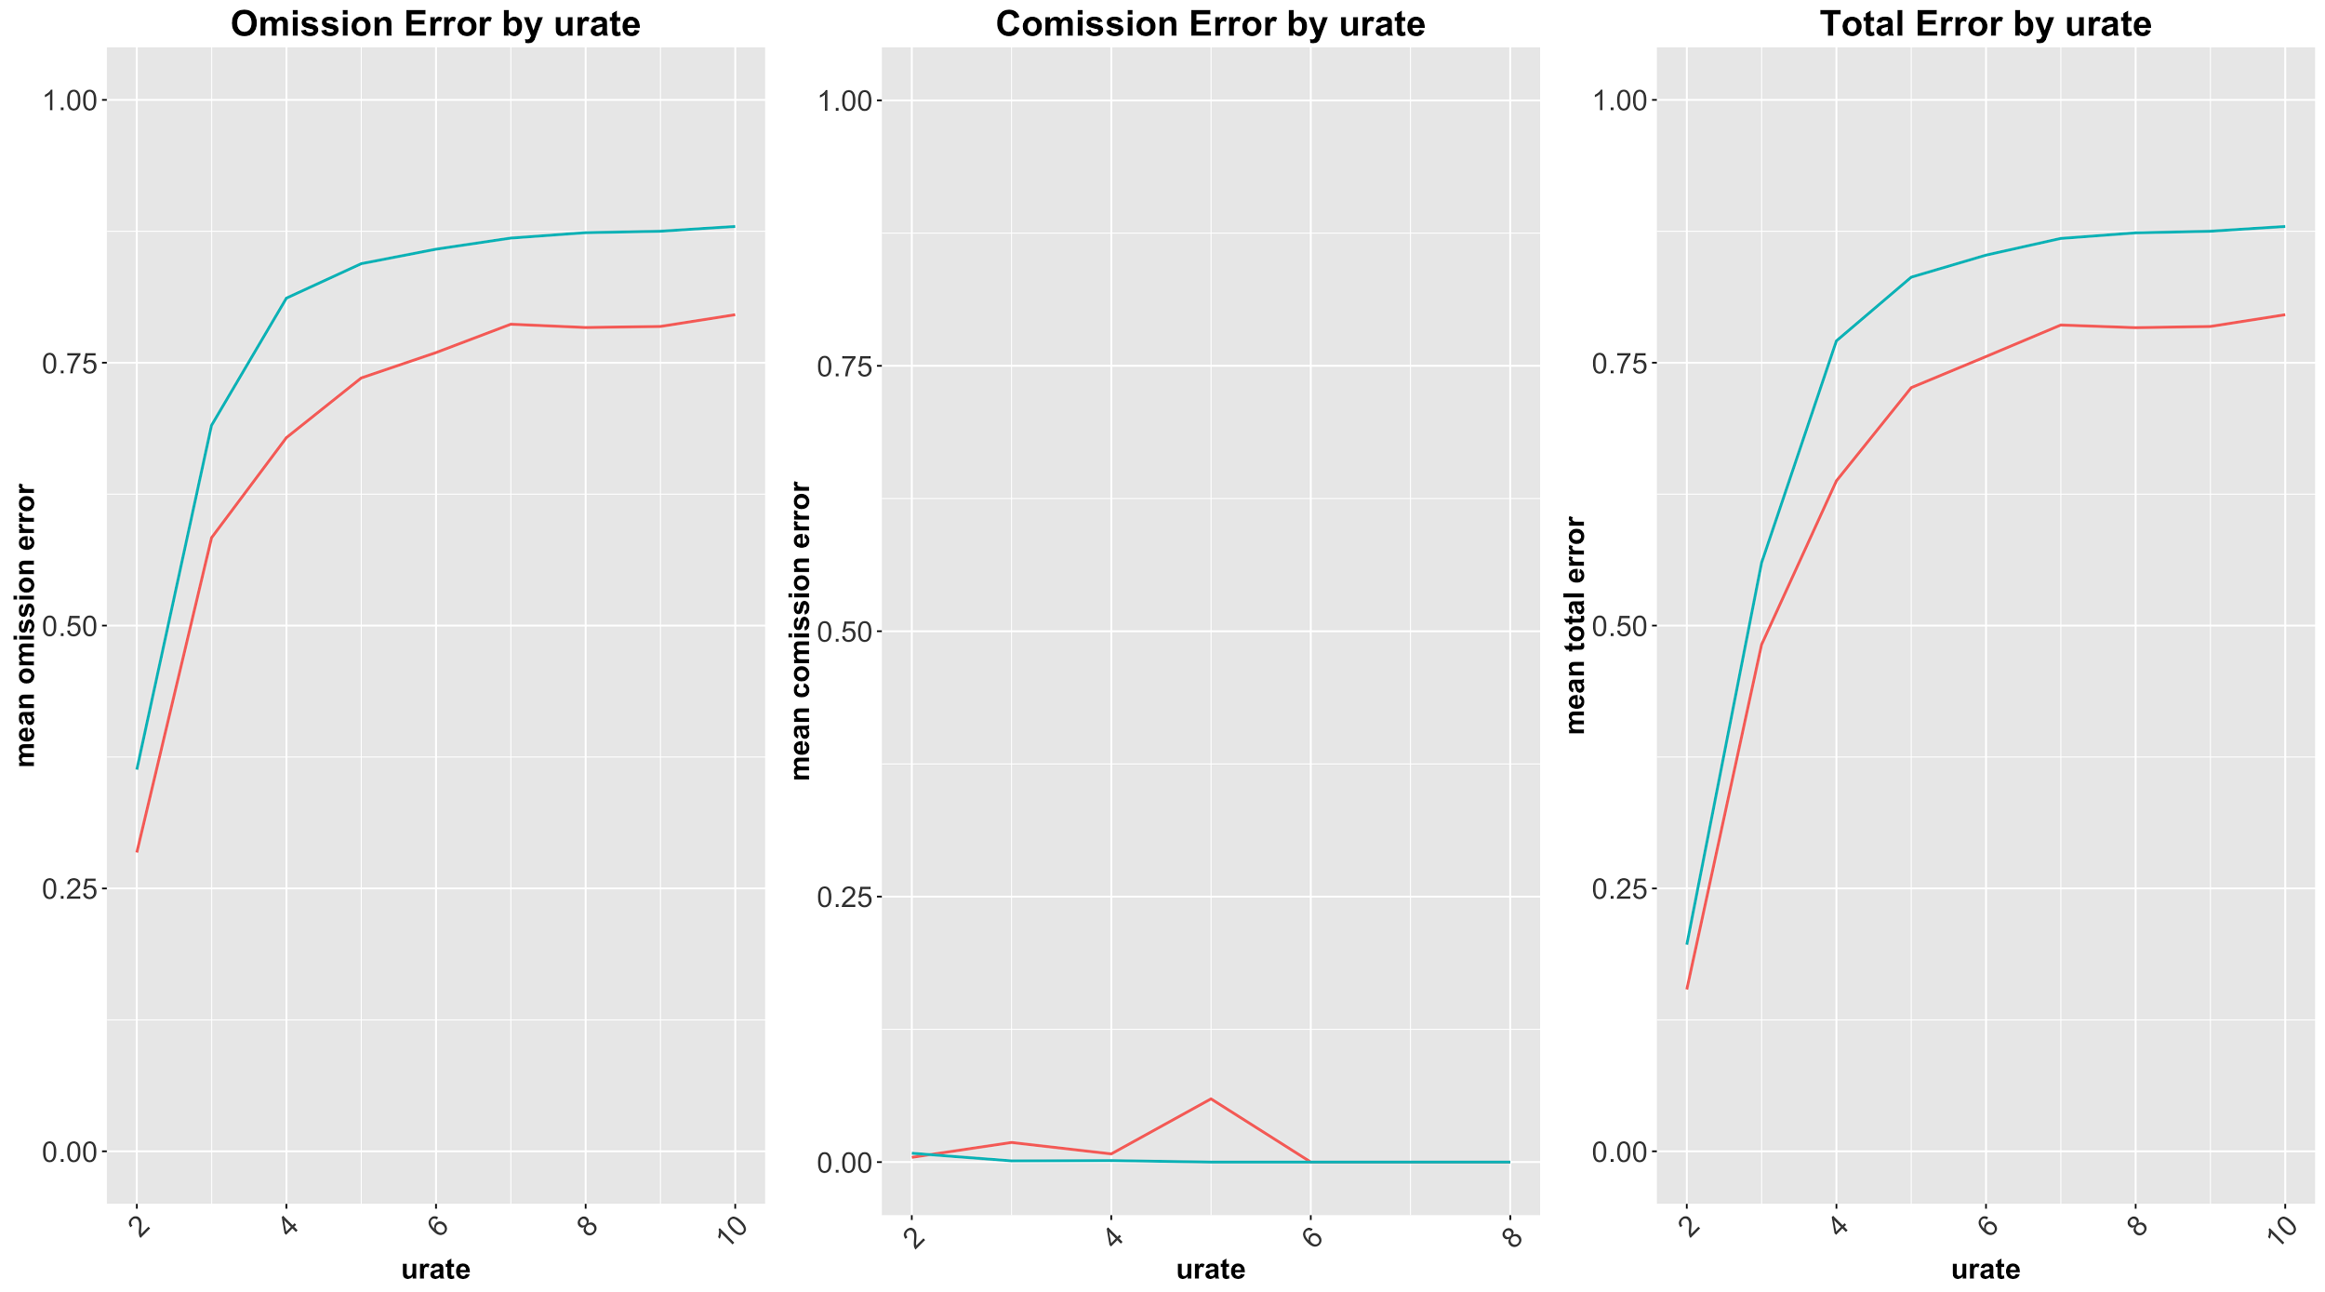
Undersampled Rate
Greater effect for Discrete Data
Error increases substantially with Urate
6 node graph
35% density
1000 sample size

Slide 27
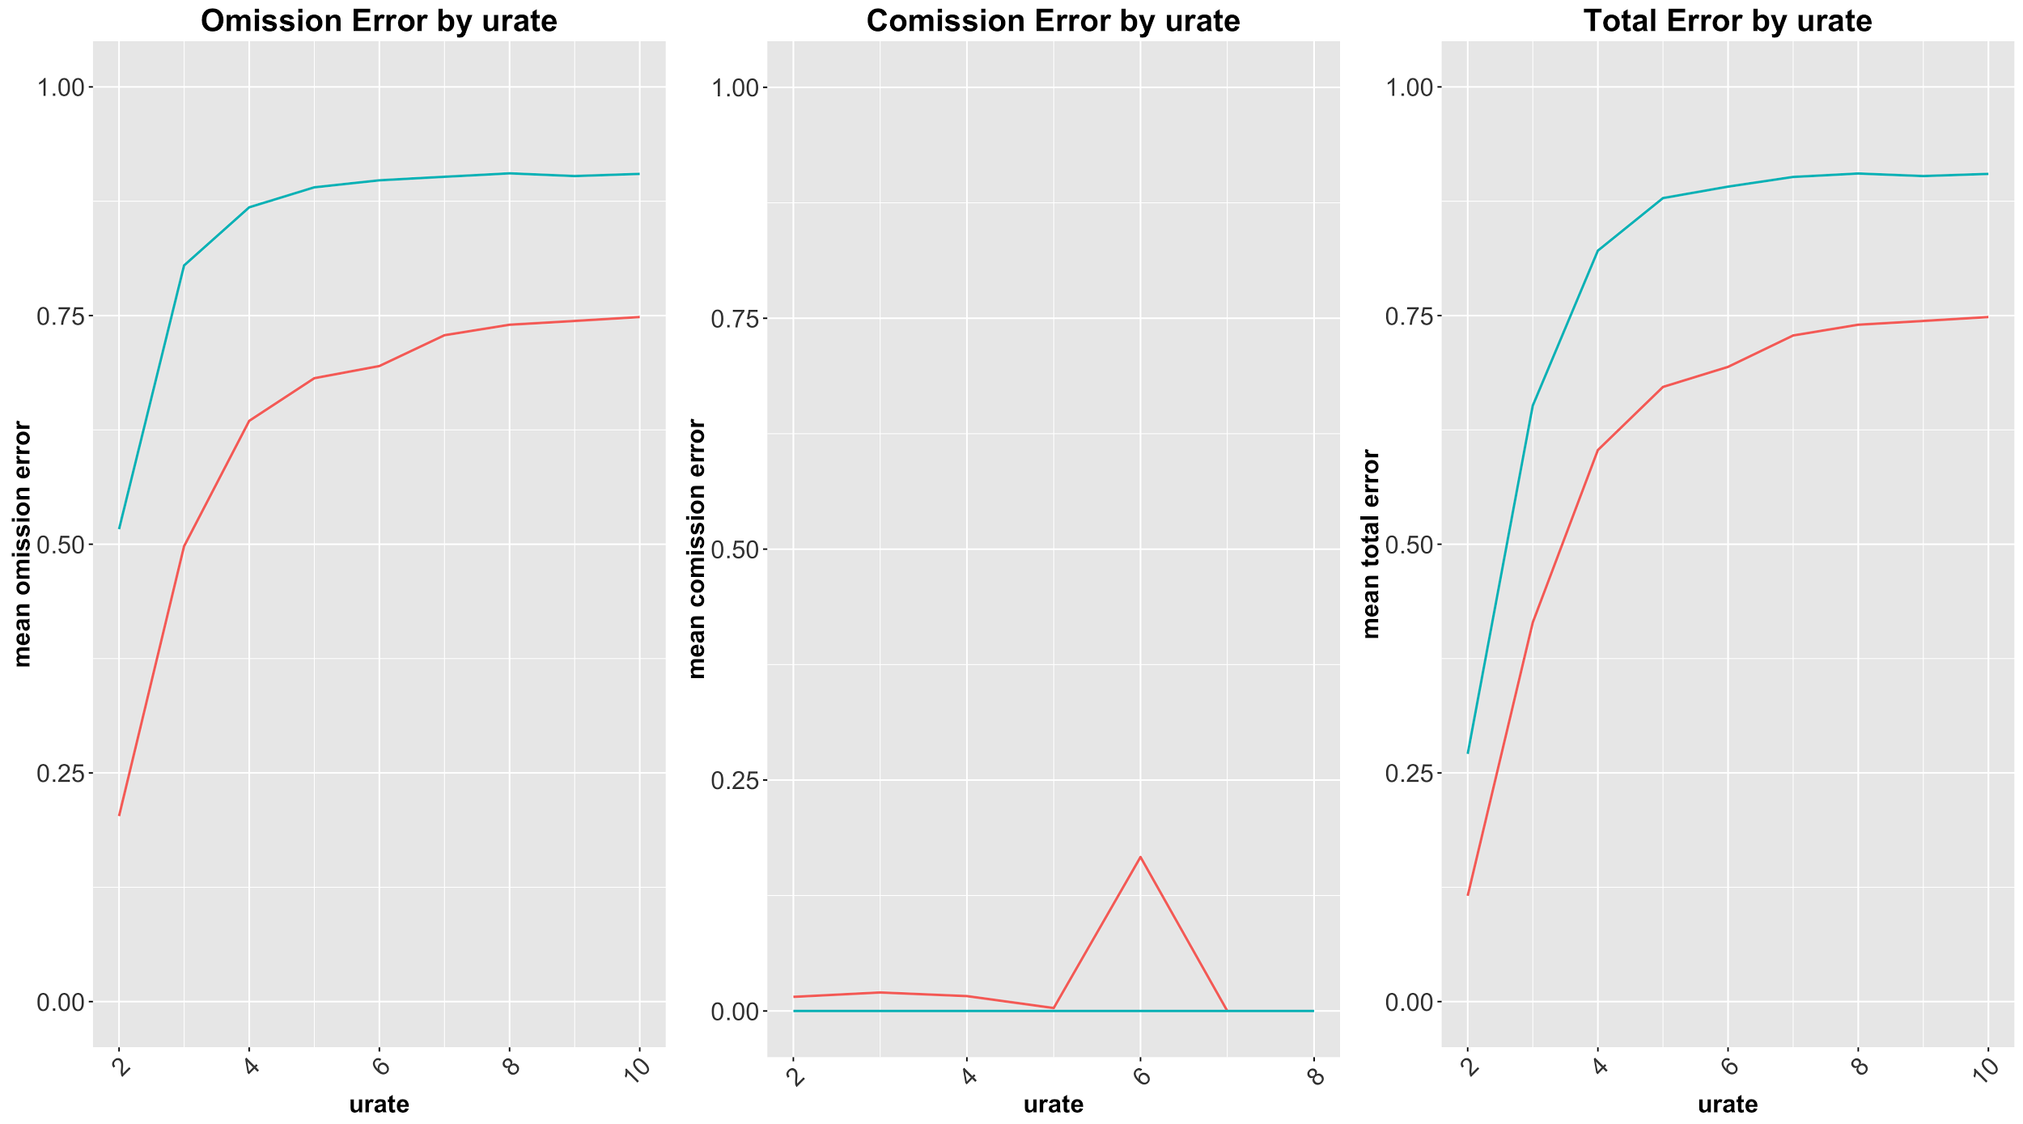
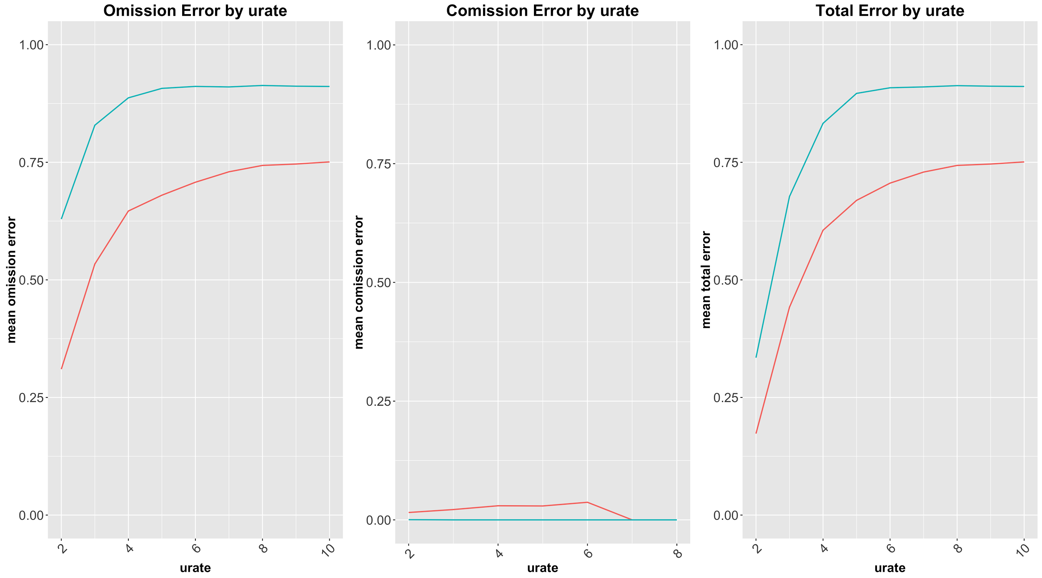
Omission Error
Arity=2 Arity=3 Arity=4

Slide 28
Questions To Answer
Which estimation methods work best?
How accurate are our G^{u} estimation methods?
(And in what cases will they work?)

Slide 29
Which Estimation Method Works Best?
Continuous Data
SVAR and Granger Causality
Discrete Data
DPC

Slide 30
How accurate are our G^{u} estimation methods?
(And in what cases will they work?)
Continuous Data
Given reasonable sample size (500-2000) and undersample rate less than 6 (for small graphs) total error is below 10%
Given a larger undersample rate or a larger graph omission error can be very high

Slide 31
How accurate are our G^{u} estimation methods?
(And in what cases will they work?)
Discrete Data
Need greater sample size than for continuous case ( > 1000)
Our DPC algorithm is robust against increasing variable arity
Estimation with undersample rates greater than 3 may be infeasible

Slide 32
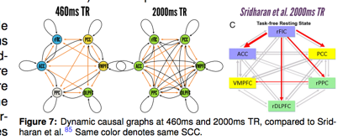
Real Example
fMRI Time Series at rates of 460 ms and 2 seconds
Compare these with the “known” graph by Sridharan et al. at 2 seconds

Slide 33
Future Research
G¹ (causal timestep) errors
ranking edge certainty
Can field experts choose best G¹ graph
Provide Python Package for easy use

Slide 34
Thank you to...
Dr. Rubin
Dr. Sergey Plis
Dr. Vince Calhoun
Dr. Patrick Mcdonald
Dr. Tyrone Ryba

Slide 36
Discrete Data Generation
Inputs:
G1 graph
Edge strength: A ∈ (0,1)
Variable Arity : m
One-Parent Case:
For each x y construct random 1-1 map.
If y = f(x) ; Set P(Y=y | X=x) = A
If y != f(x) ; Set P(Y=y | X=x) = (1-A)/(m-1)
Multiple-Parent Case:
For each parent x, construct random 1-1 map.
Set P(Y=y | X₁ =x₁ , … , X_{n} =x_{n} ) to be the renormalized product of the X_{i} specific distributions

Slide 37
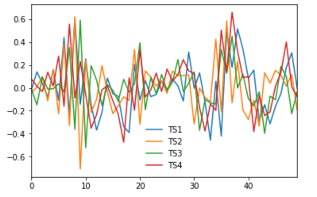
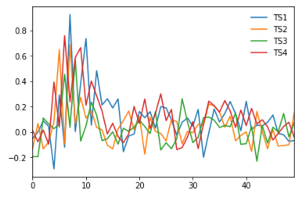
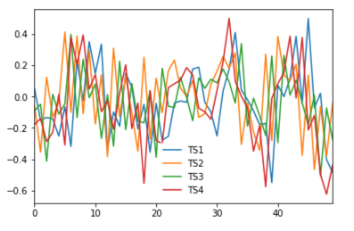
Continuous Data Generation
PseudoCode:
While stable transition matrix not found:
Get G1 graph of specific nodes and % density
Try to find stable transition matrix
Create complete time series from transition matrix
Undersample time series at given undersampling rate
Our data generation may bias SVAR results
Repeat Analysis on Constrained time series
0 minimum Constraint
Tanh constraint
INSERT TIME SERIES PLOTS OF:
NON-CONSTRAINED
0 MIN
￼

Slide 38
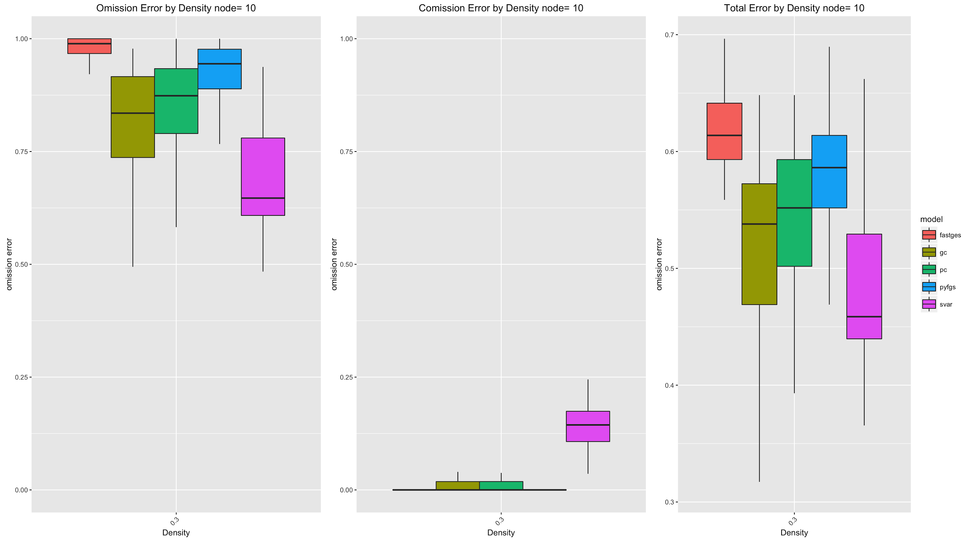
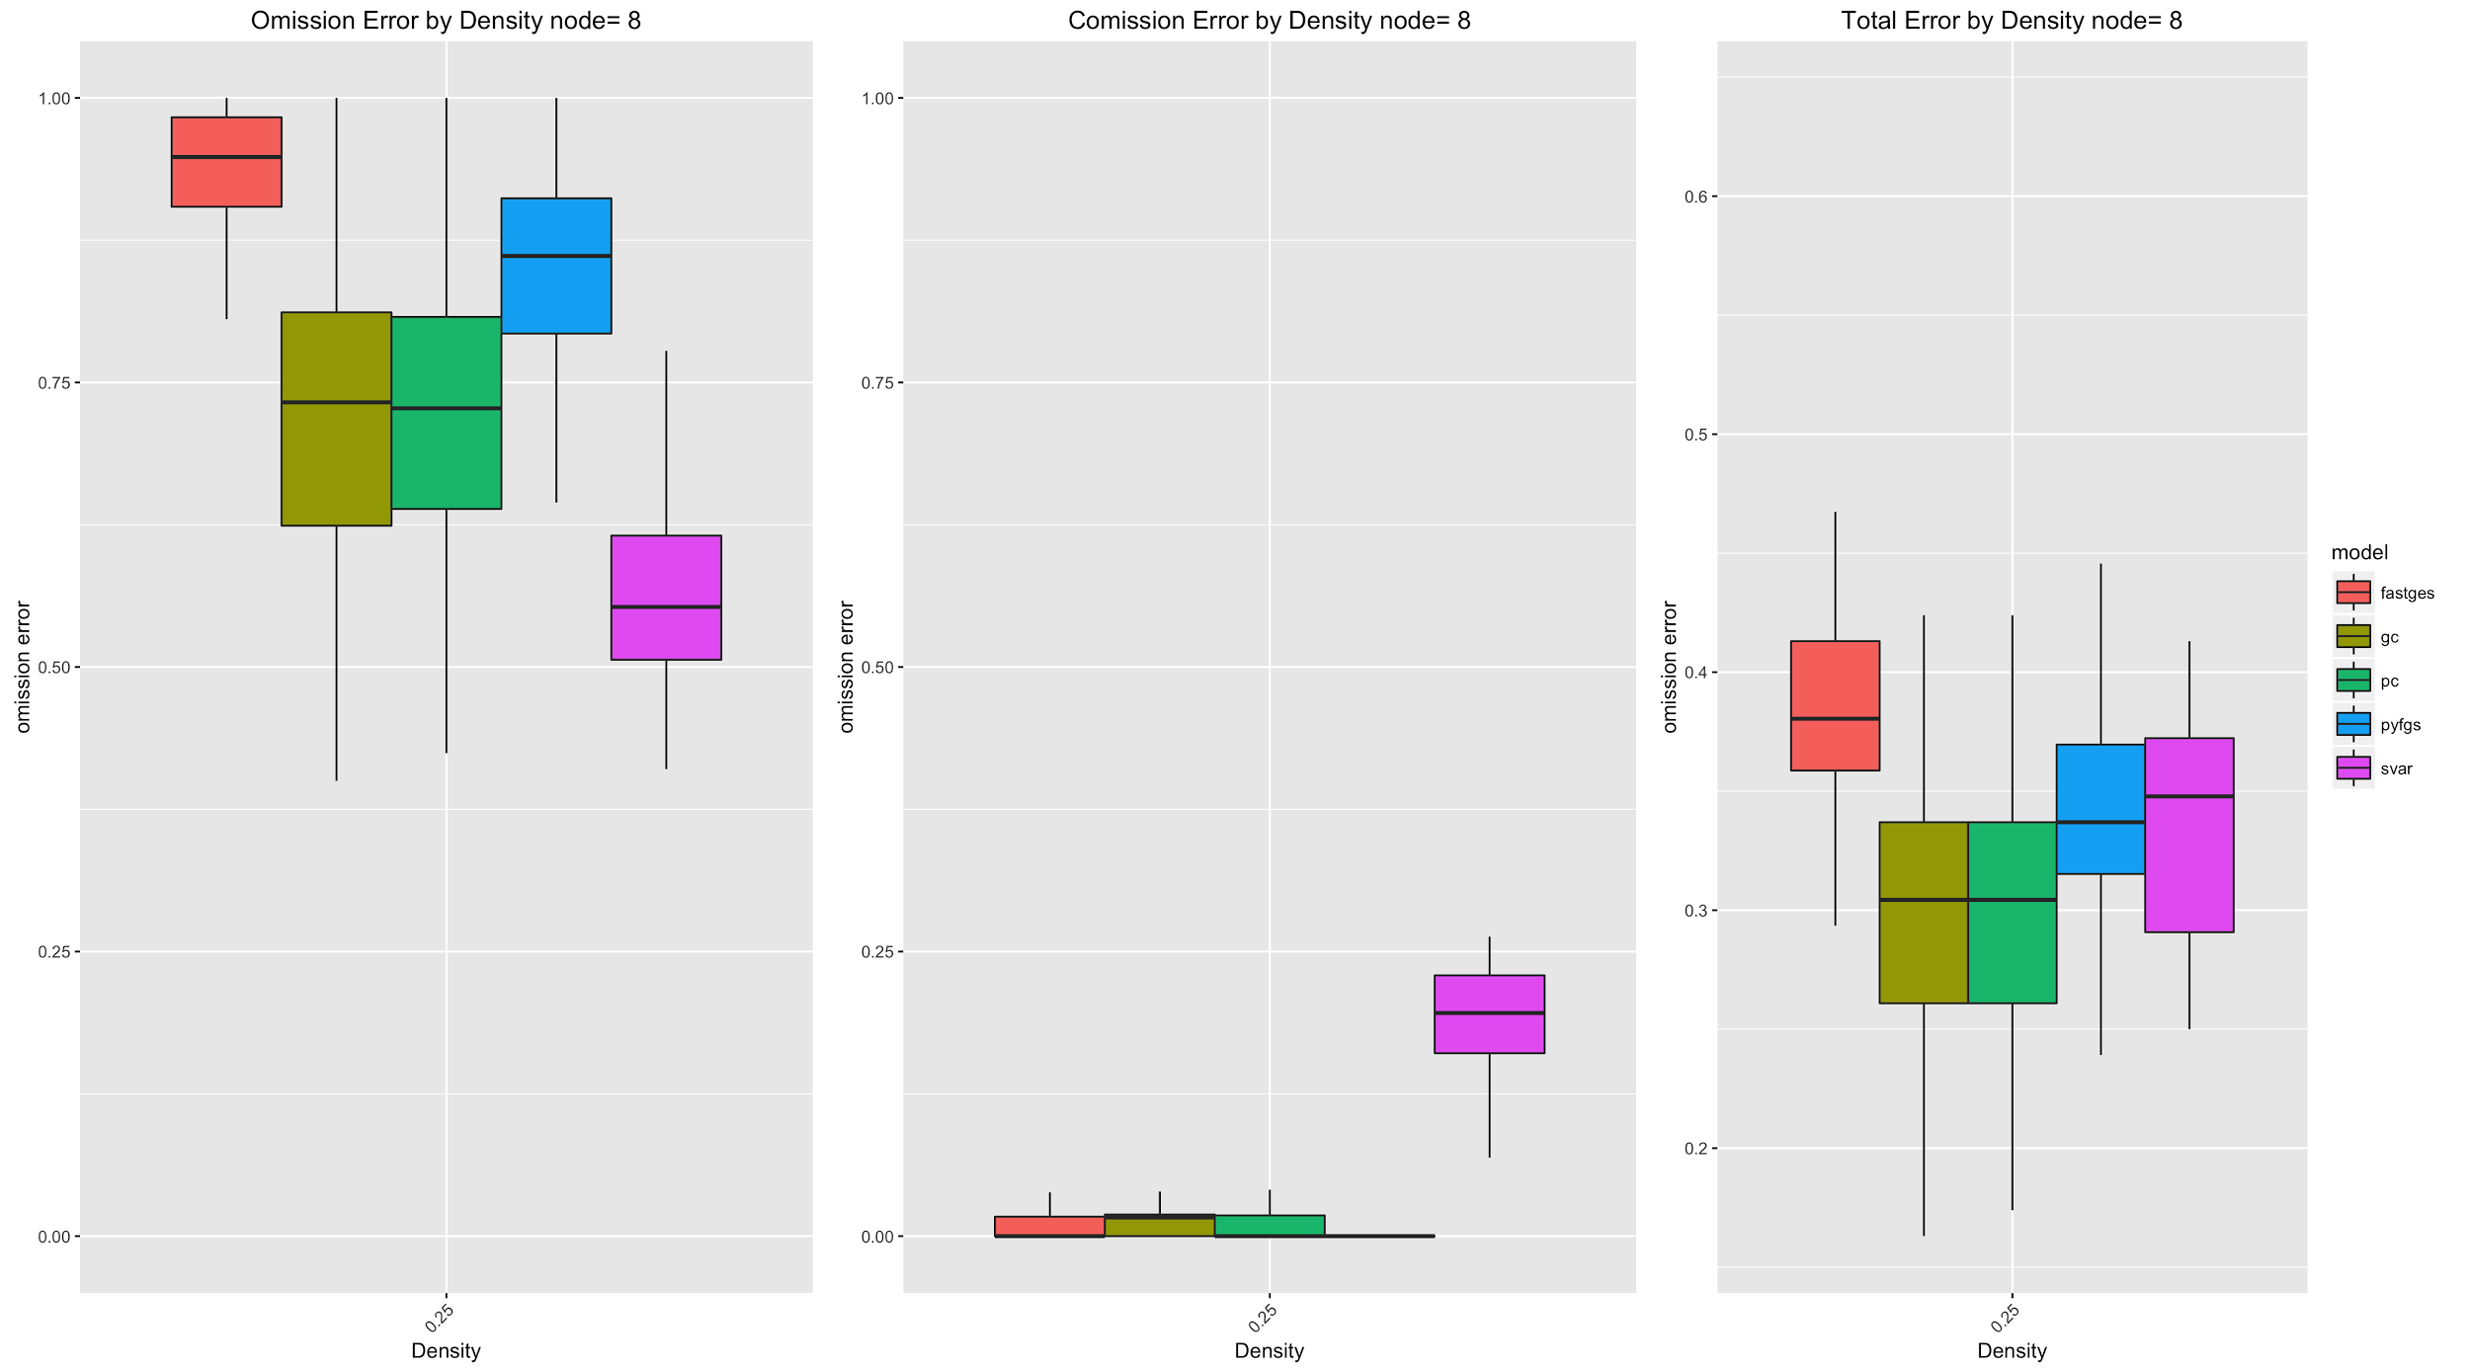
Min 0 Constraint Plots
Further Analysis halted due to such a high Omission Error

Slide 39
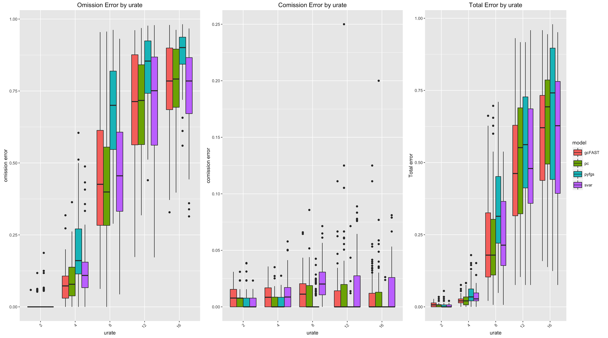
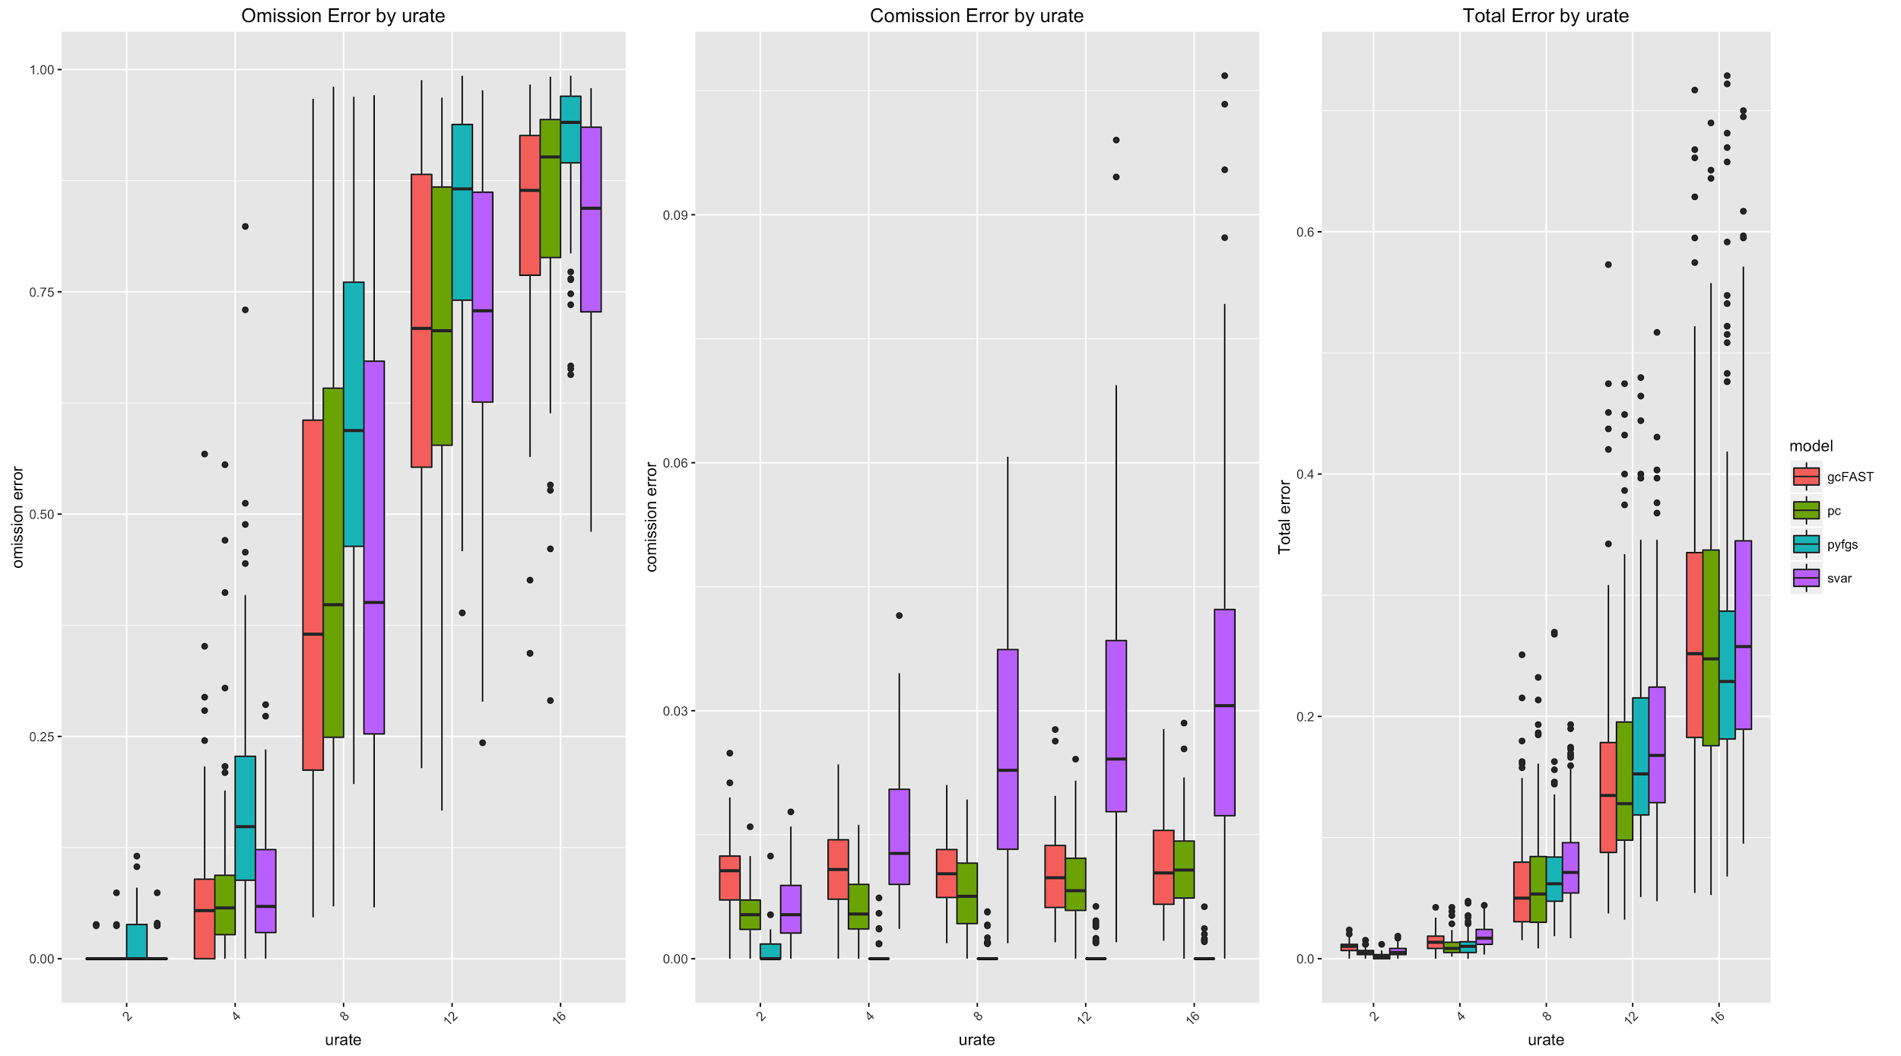
Urate Tanh Model
SVAR has slightly worse performance
10 Node 2 “extra edges” 20 Node 2 “extra edges”

Slide 40
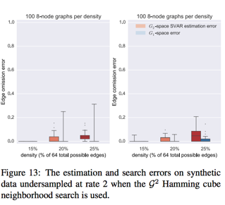
Previous Work
Assumptions:
First-Order Markov
No isochronal edges in G¹
Graph structure in G² space can be found
G¹ projection can deliver correct answer
Sergey Plis, David Danks, Jianyu Yang. Mesochronal Structure Learning. 2015

Slide 41
Model Evaluation
Generate G¹ graph
Generate time series from G¹ graph
Create undersampled true G^{u} graph
Input time series undersampled by rate u to causal discovery algorithm
Compare Output G^{u} graph to true G^{u} graph.

Slide 42
Models Tested
Continuous Data
SVAR
PC Algorithm
Greedy Equivalence Search
Granger Causality
Discrete Data
PC Algorithm
Globally Optimal Bayesian Network learning using Integer Linear Programming(GOBNILP)

Slide 43
Continuous Data Case

Slide 44
SVAR
Use statsmodels to approximate Vector Autoregressive Model, i.e. obtain directed edges
Then minimizes negative log likelihood to find bidirected edges

Slide 45
PC Algorithm
Start with fully connected graph
Test each directed edge for independence using OLS conditional on all parent sets(from null set to full parent set)
For directed edge X Y, if X and Y are independent given any set of parents, remove their edge.
Test each bidirected edge for independence using OLS conditional on full parent set
For bidirected edge X Y, if X and Y are independent given full parent set, remove their edge.

Slide 46
Greedy Equivalence Search
Start with empty graph
Score each possible edge
Add best edge to graph
Rescore directed edges affected by edge addition, conditioning on graphs current edges
Repeat 3 and 4 until no edges improve graph’s score
Repeat steps except with edge deletion
Interpret graph edges based on our model
Unconstrained Tetrad Implementation performed better than both our new implementation as well as Constrained Tetrad.

Slide 47
Granger Causality
Start with fully connected graph
For each directed edge, X_{i} Y, compare model X₁,...,X_{n} Y to X₁,...X_{i-1},X_{i+1},...,X_{n} Y.
If the models are not significantly different remove X_{i} Y
For each bidirected edge, X Y, compare model S_{t-1},X Y to S_{t-1} Y, where S_{t-1} is the set of all previous timestep nodes.
If the models are not significantly different remove X Y

Slide 48
Continuous Data Generation
PseudoCode:
While stable transition matrix not found:
Get G1 graph of specific nodes and % density
Try to find stable transition matrix
Create complete time series from transition matrix
Undersample time series at given undersampling rate
Our data generation may bias SVAR results
Repeat Analysis on Constrained time series
0 minimum Constraint
Tanh constraint
INSERT TIME SERIES PLOTS OF:
NON-CONSTRAINED
0 MIN
￼

Slide 49
How the Models are Tested
Omission Error
Commission Error
Total Error

Slide 50
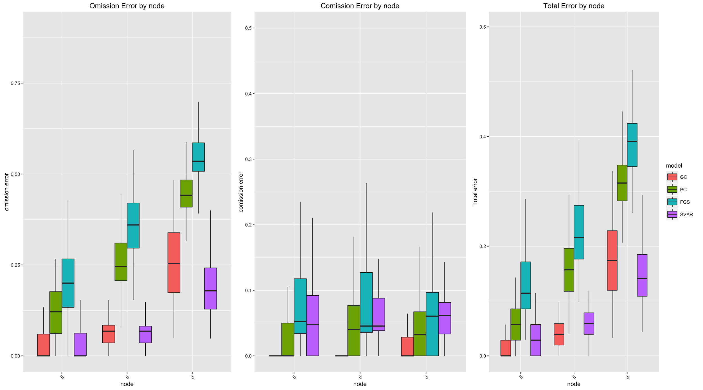
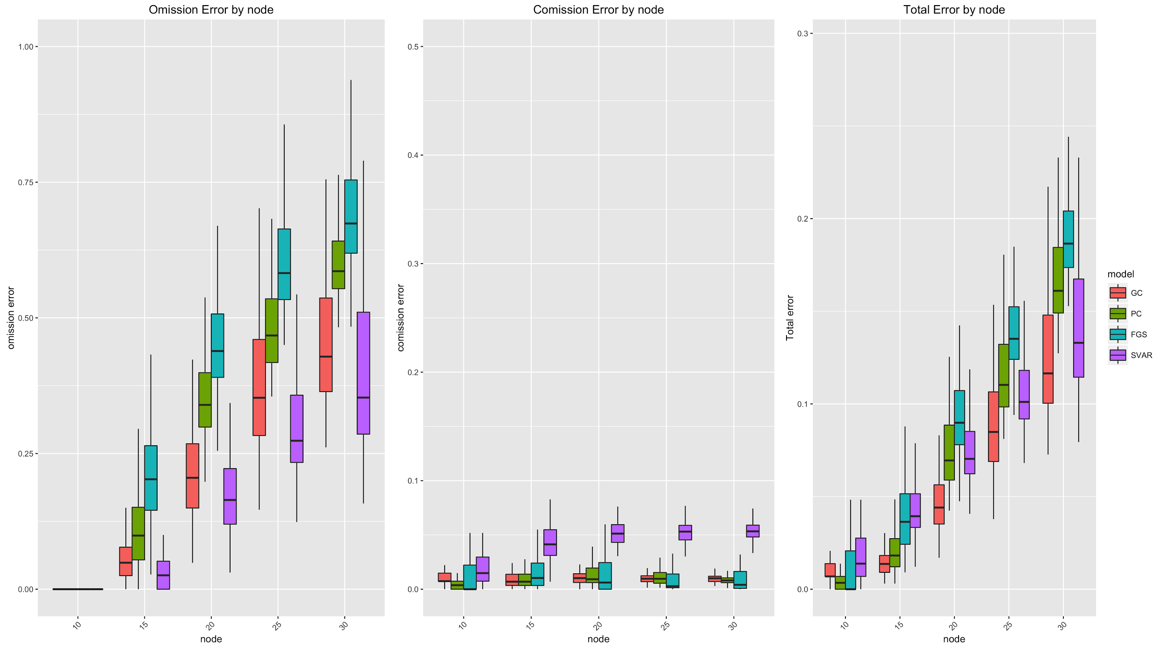
Graph Size For Continuous Data
500 Effective Sample Size
Urate=2
5,6,8 node 35% graph 10,15,20,25,30 node 10% graph
Notes:
500 Sample Size

Slide 51
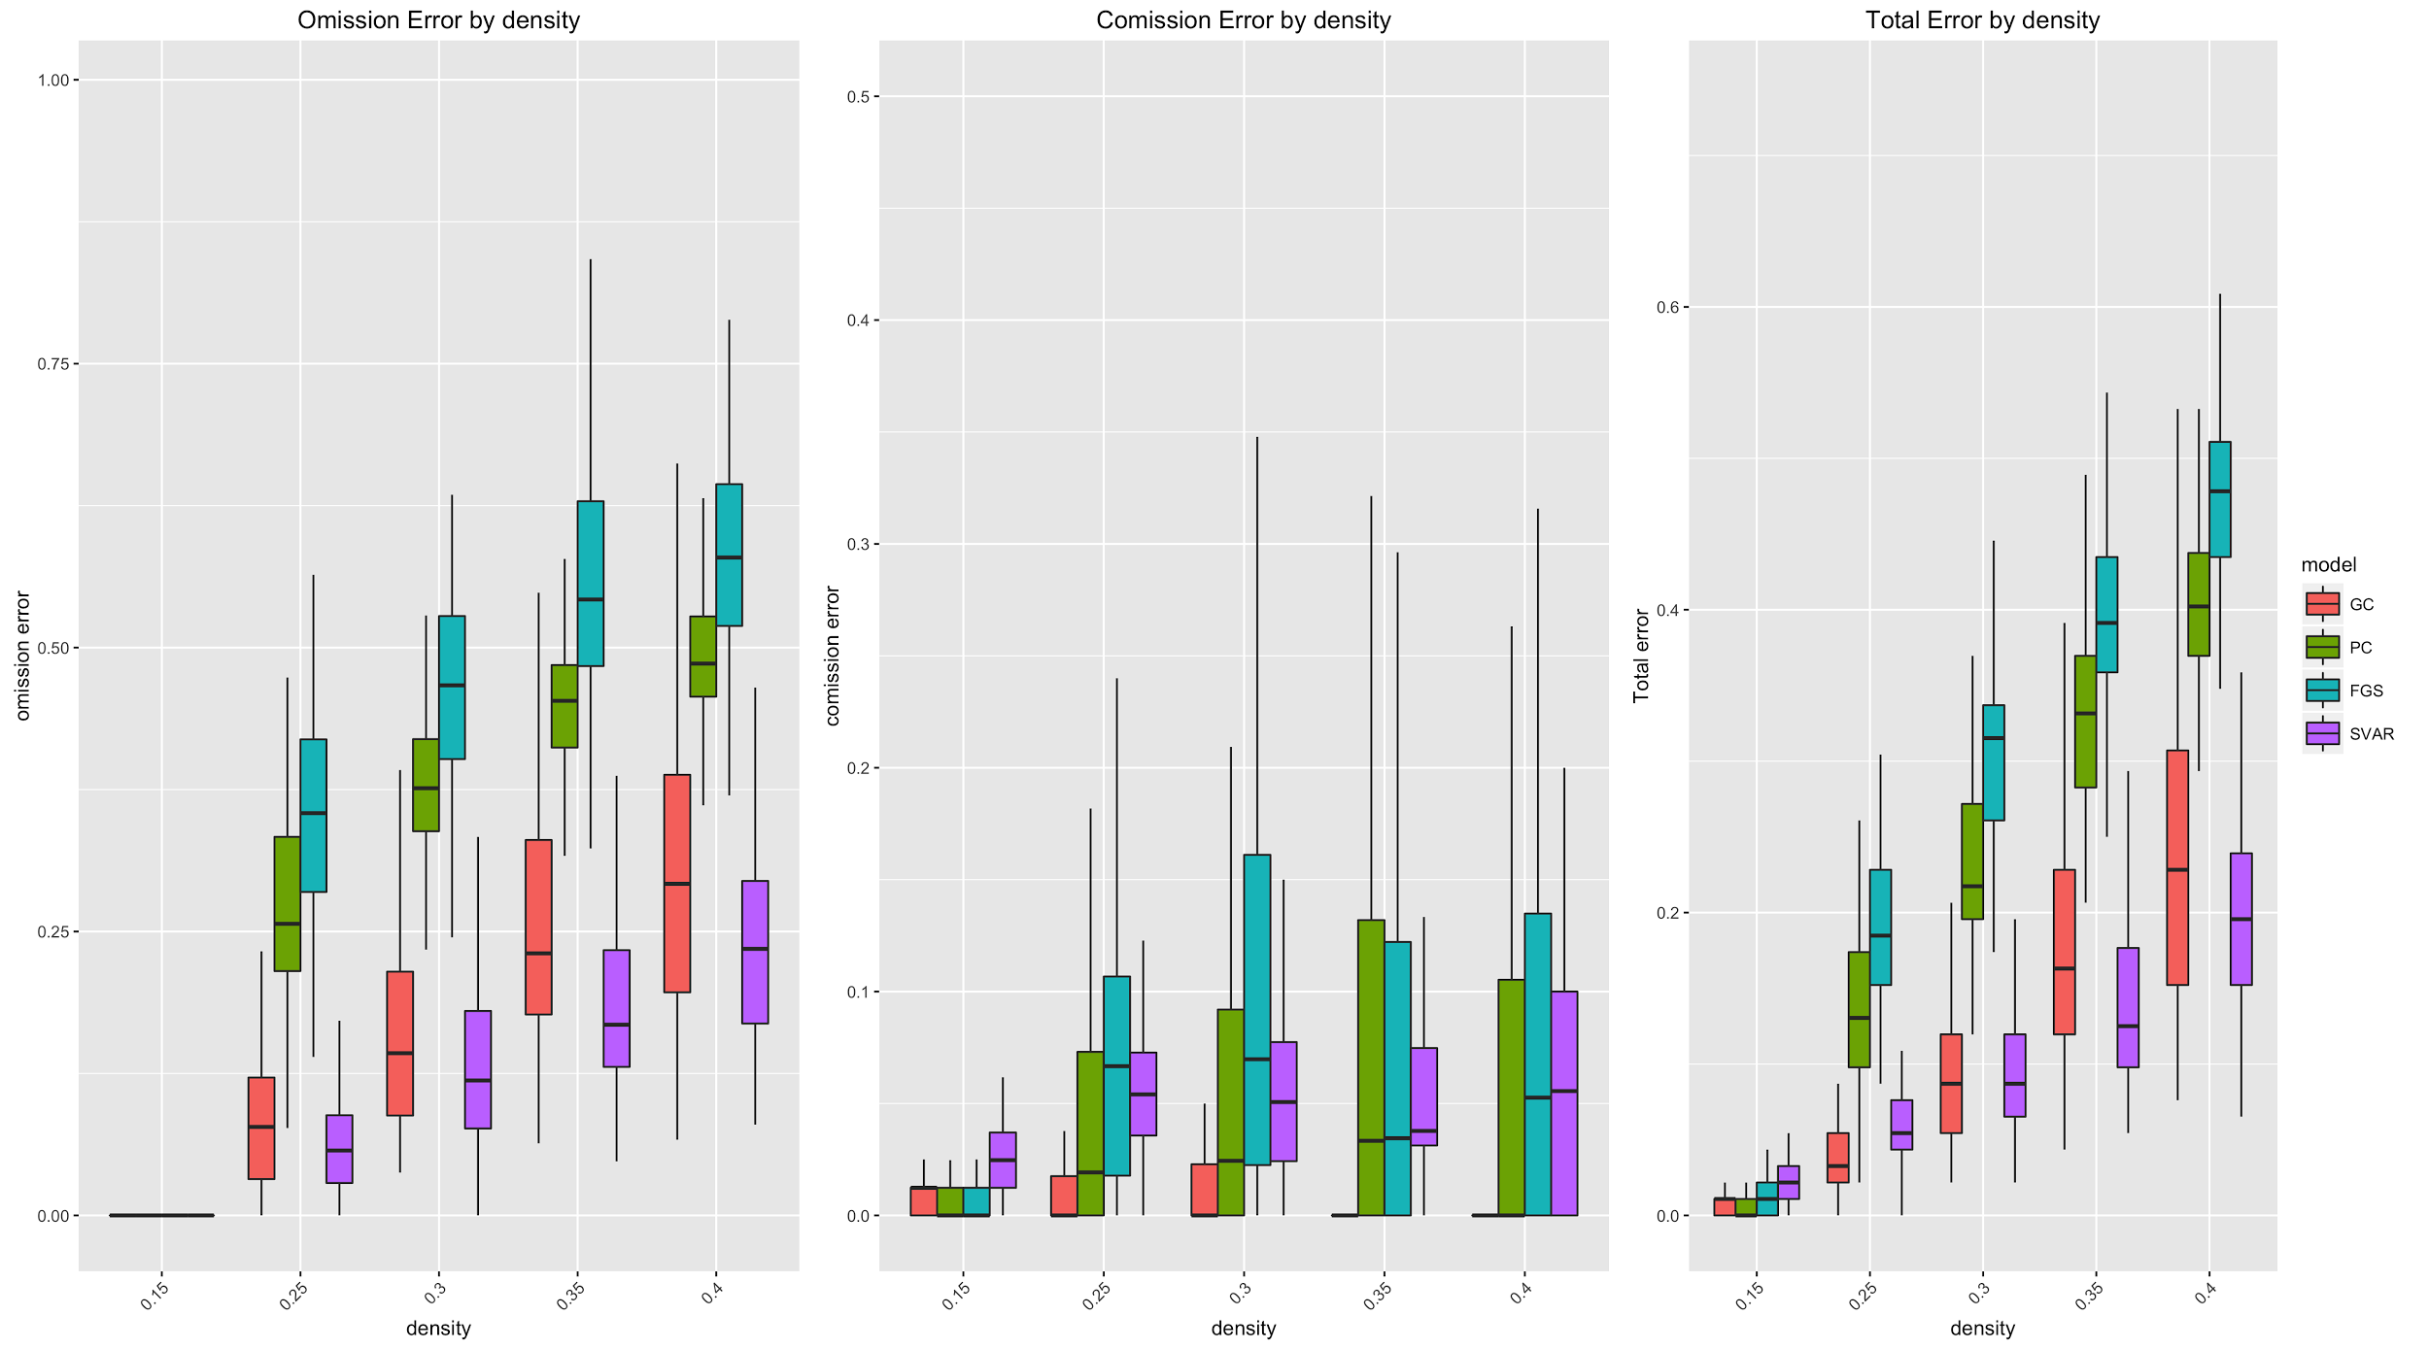
Density For Continuous Data
500 Sample Size
Urate=2
8 node graph

Slide 52
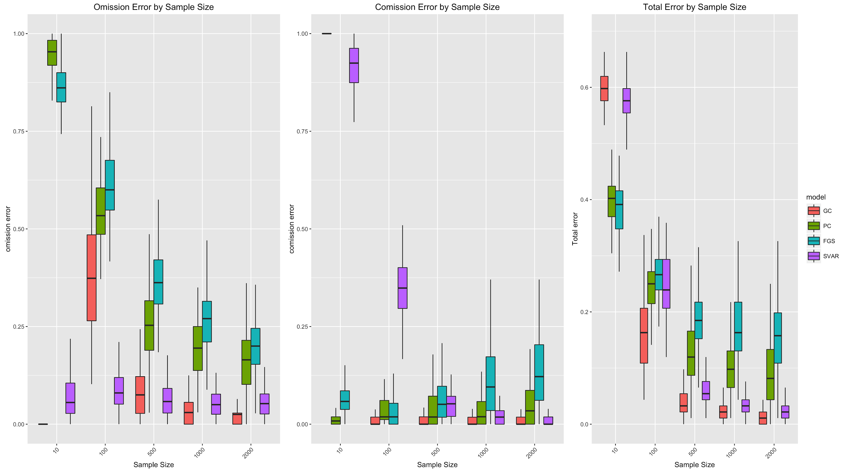
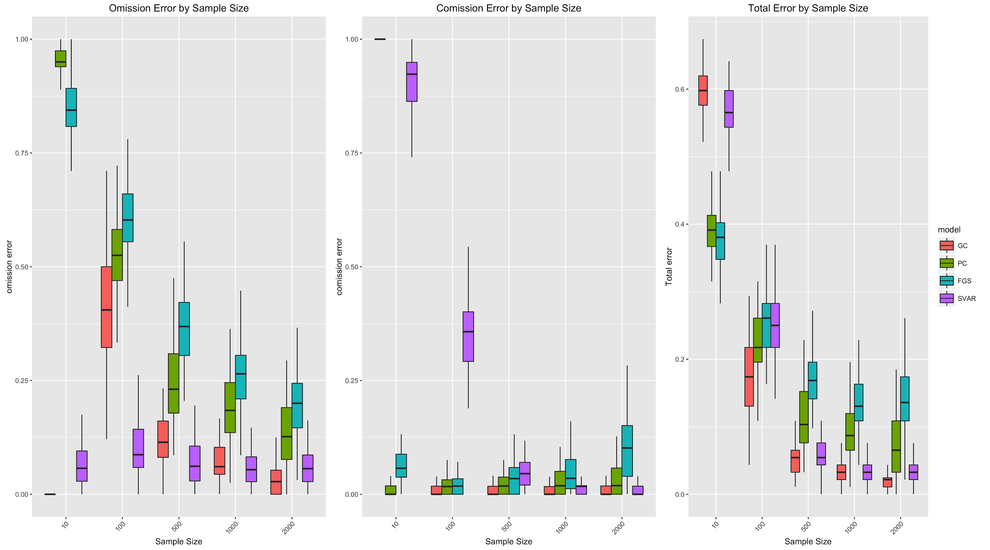
Sample Size For Continuous Data
Variables=8 Density=25% Urate=2
Original Model Tanh Model

Slide 53
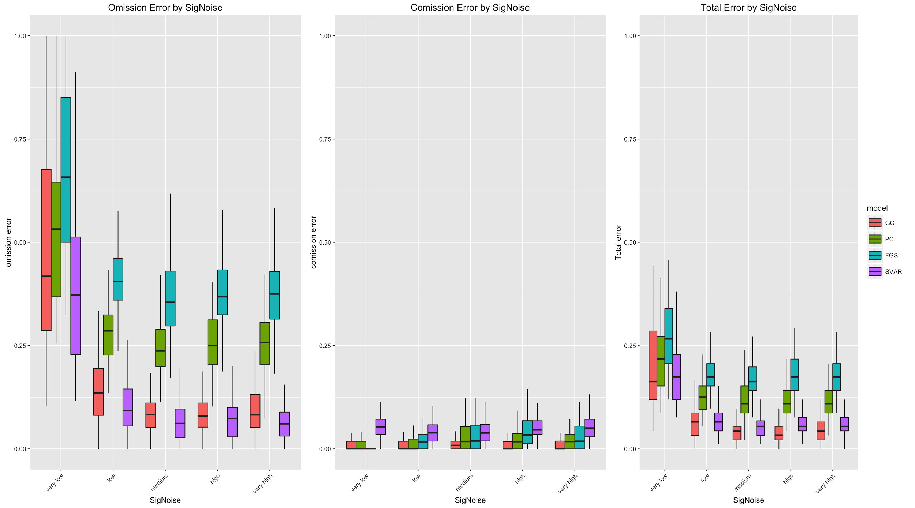
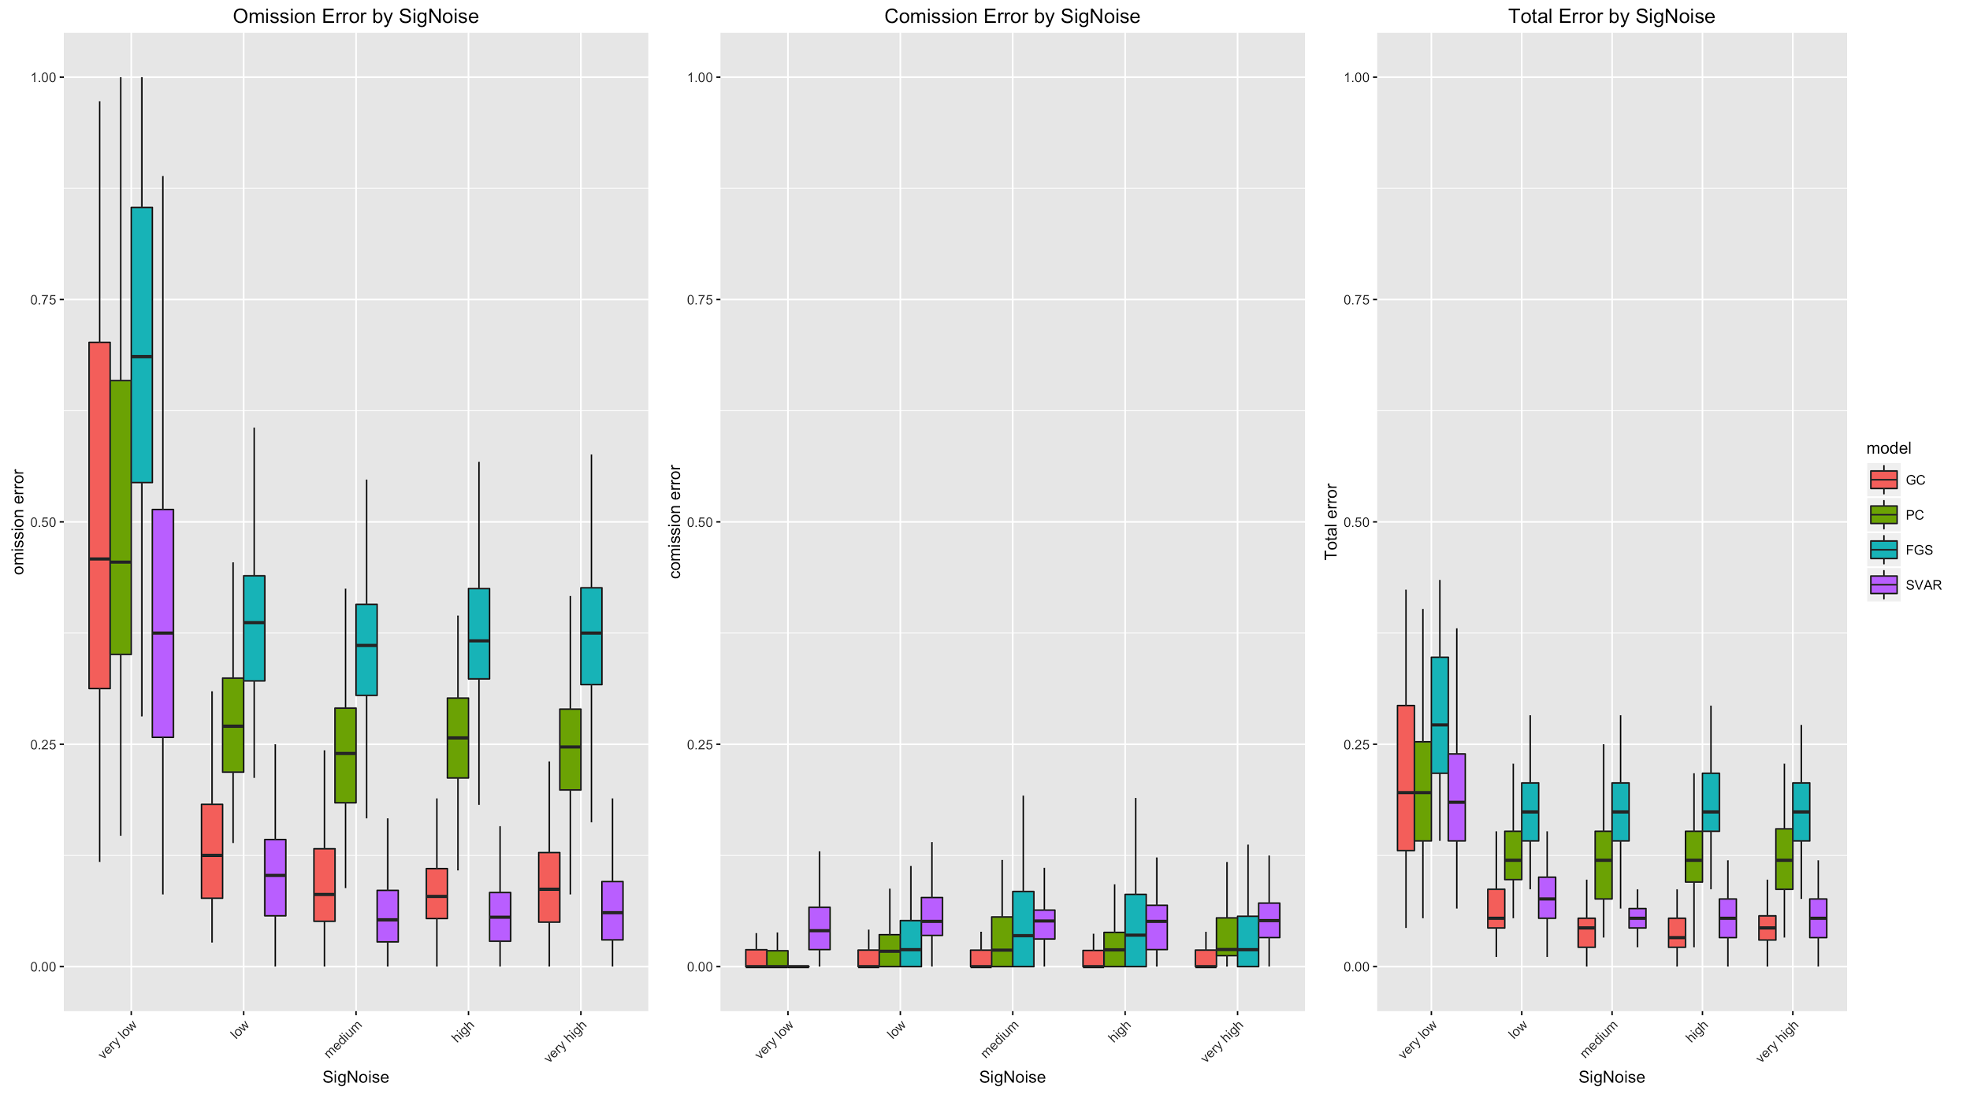
Signal To Noise Ratio for Continuous Data
Very Low Low Medium High Very High
Ratio: 1 3 6 9 12
Original Model Tanh Model

Slide 54
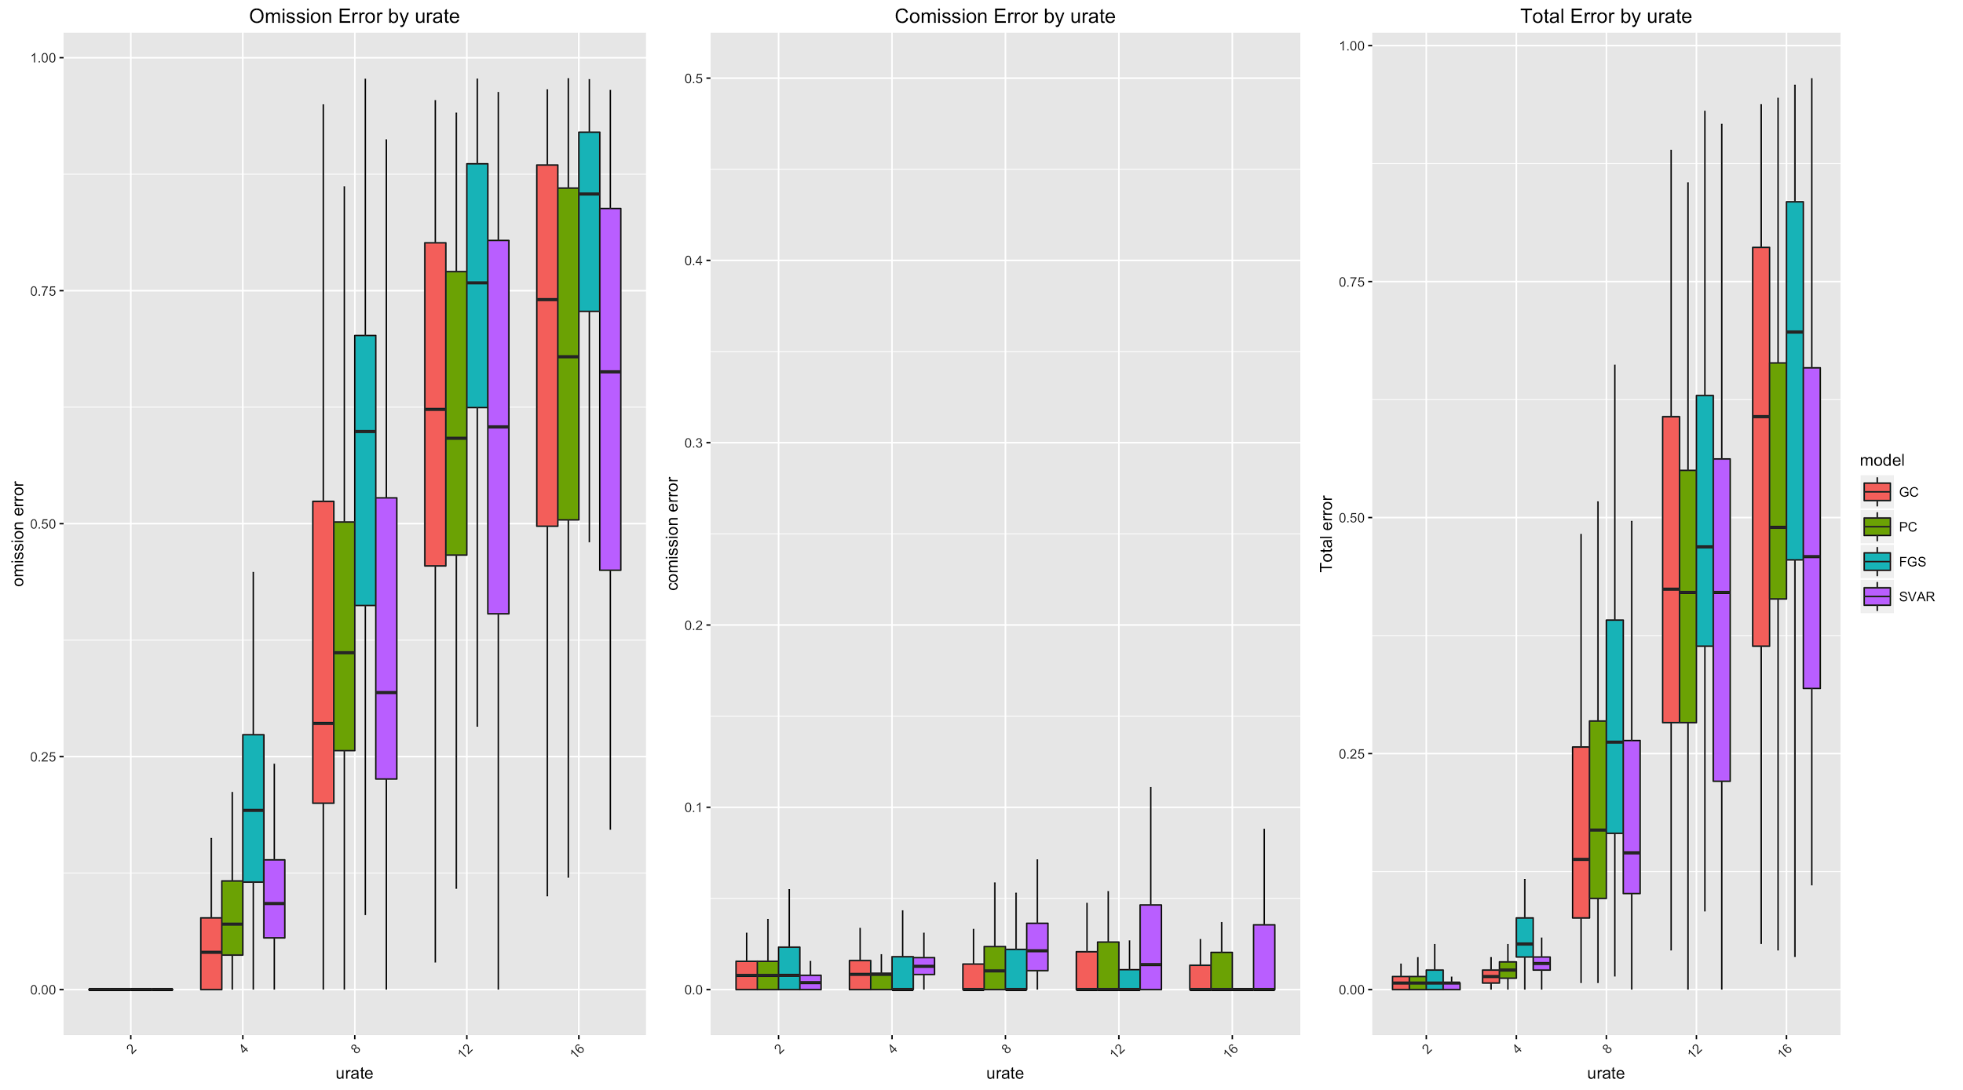
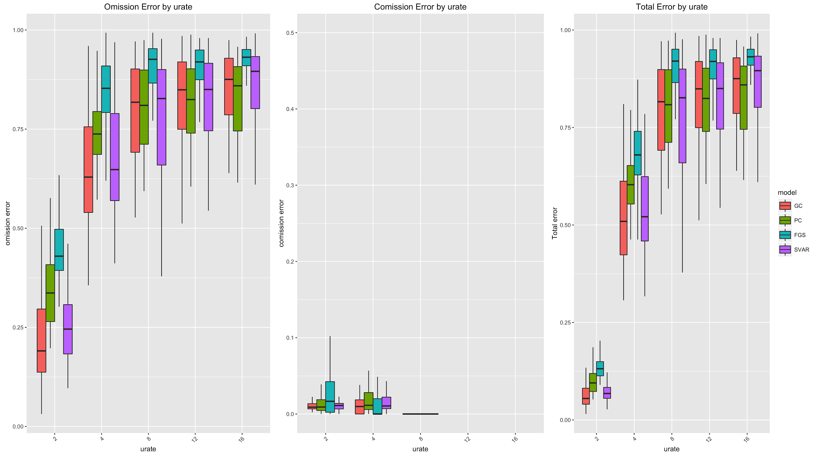
Urate for Continuous Data
Hoped for a given density, total error is similar across all graph sizes
10 Node 12% Density 20 Node 12% Density

Slide 55
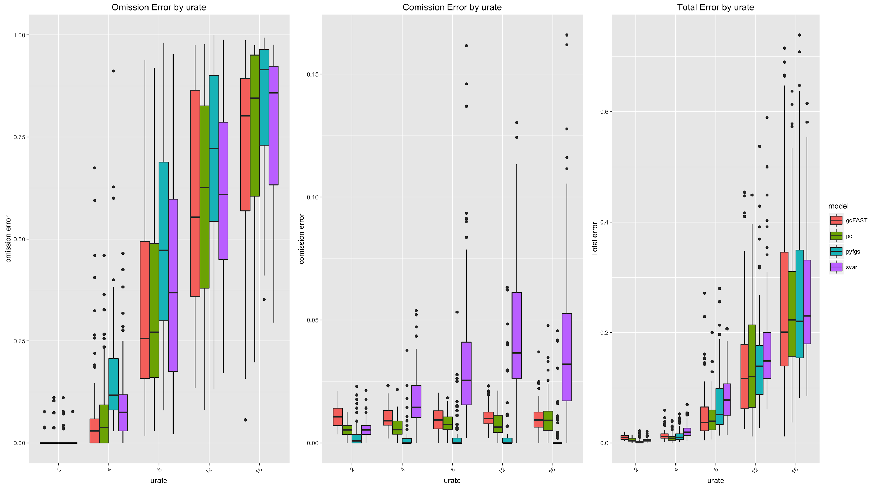
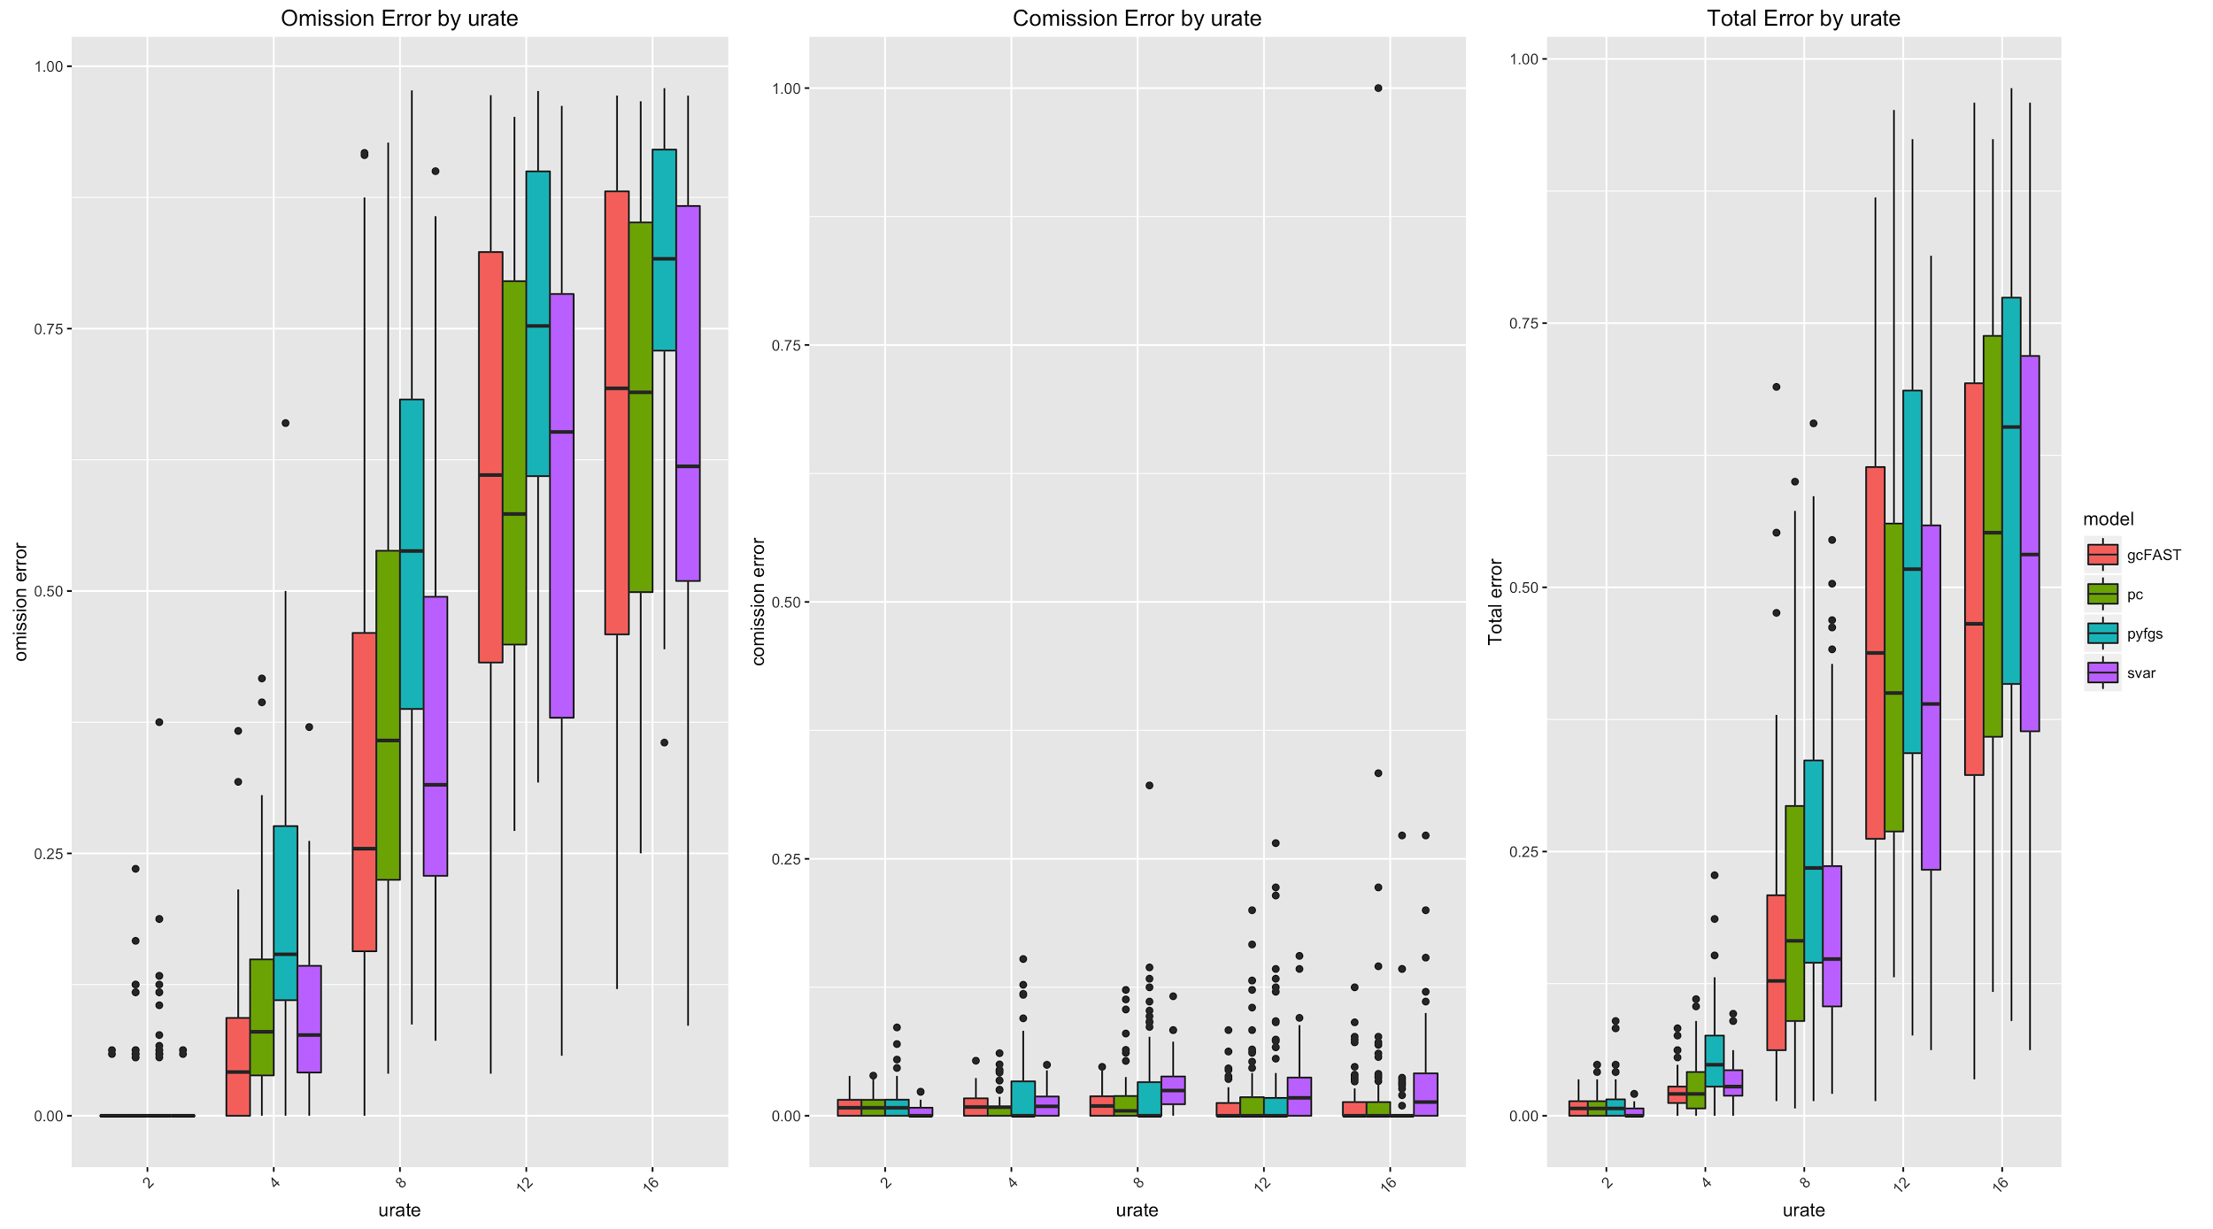
Urate for Continuous Data (Continued)
Error is more consistent across graph sizes for a given number of “extra edges” than for a given density
10 Node 2 “extra edges” 20 Node 2 “extra edges”
10 Node 2 “extra edges” 20 Node 2 “extra edges”

Slide 56
Discrete Data Case

Slide 57
Discrete Data Generation
Inputs:
G1 graph
Edge strength: A ∈ (0,1)
Variable Arity : m
One-Parent Case:
For each x y construct random 1-1 map.
If y = f(x) ; Set P(Y=y | X=x) = A
If y != f(x) ; Set P(Y=y | X=x) = (1-A)/(m-1)
Multiple-Parent Case:
For each parent x, construct random 1-1 map.
Set P(Y=y | X₁ =x₁ , … , X_{n} =x_{n} ) to be the renormalized product of the X_{i} specific distributions

Slide 58
GOBNILP
C program which learns Bayesian Networks from discrete data
Searches for the Bayesian Network with the highest BDeu Score (log marginal likelihood)
GOBNILP manual https://www.cs.york.ac.uk/aig/sw/gobnilp/

Slide 59
Discrete PC Algorithm
Same as Continuous PC Algorithm except:
Replaced OLS conditional independence test with conditional 𝝌² -test
Conditional 𝝌² -test
Sum 𝝌² and degrees of freedom for each combination of conditional variable values.
Then calculate p-value of the summed 𝝌² and degrees of freedom

Slide 60
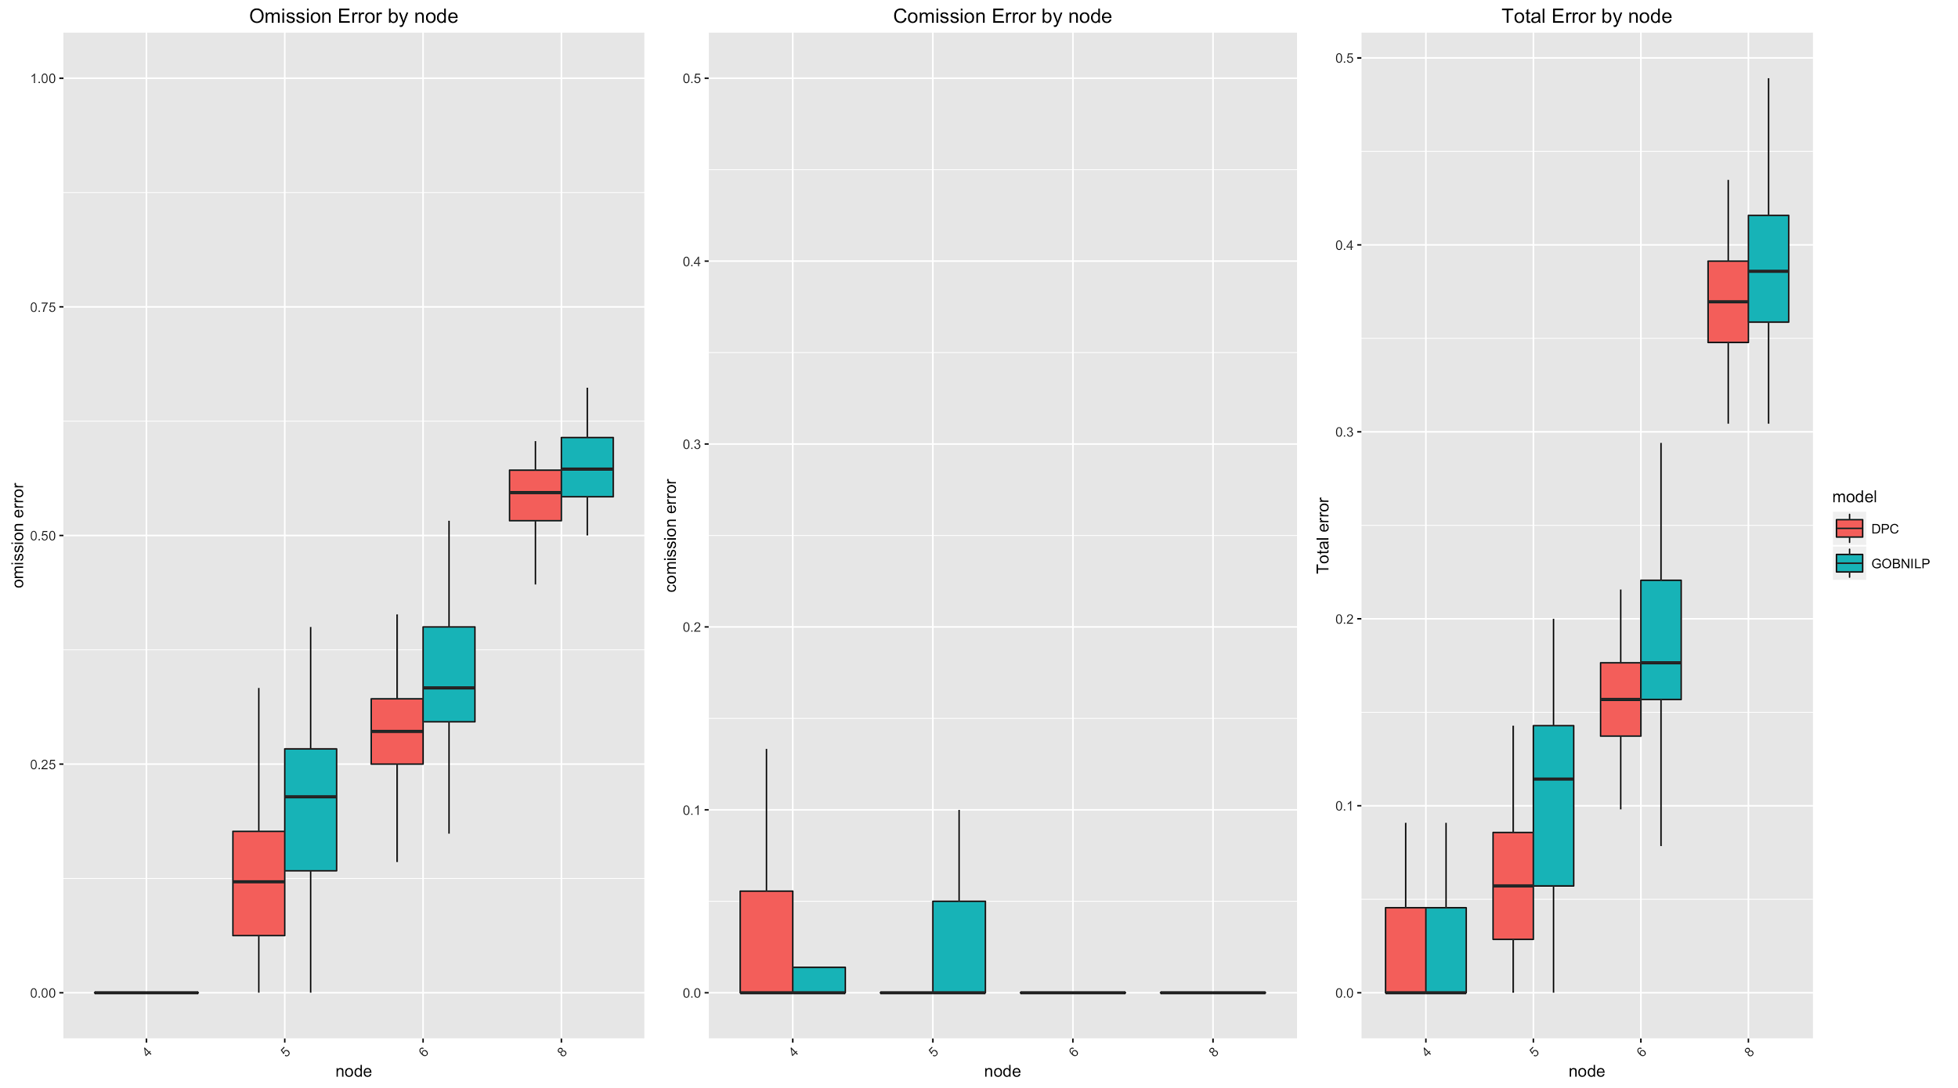
Graph Size for Discrete Data
1000 Effective Sample Size
35% density
Urate=2

Slide 61
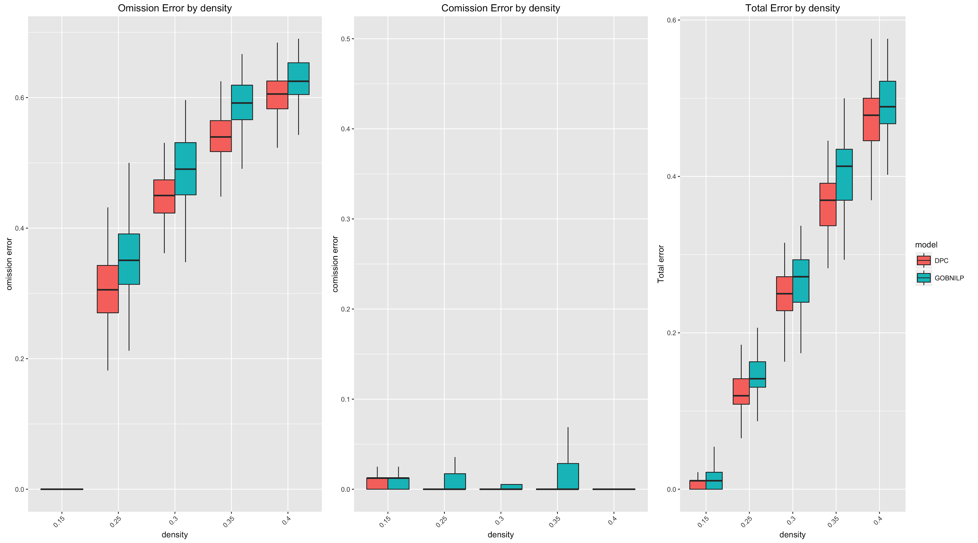
Density for Discrete Data
8 node graph
1000 Effective Sample Size
Urate=2

Slide 62
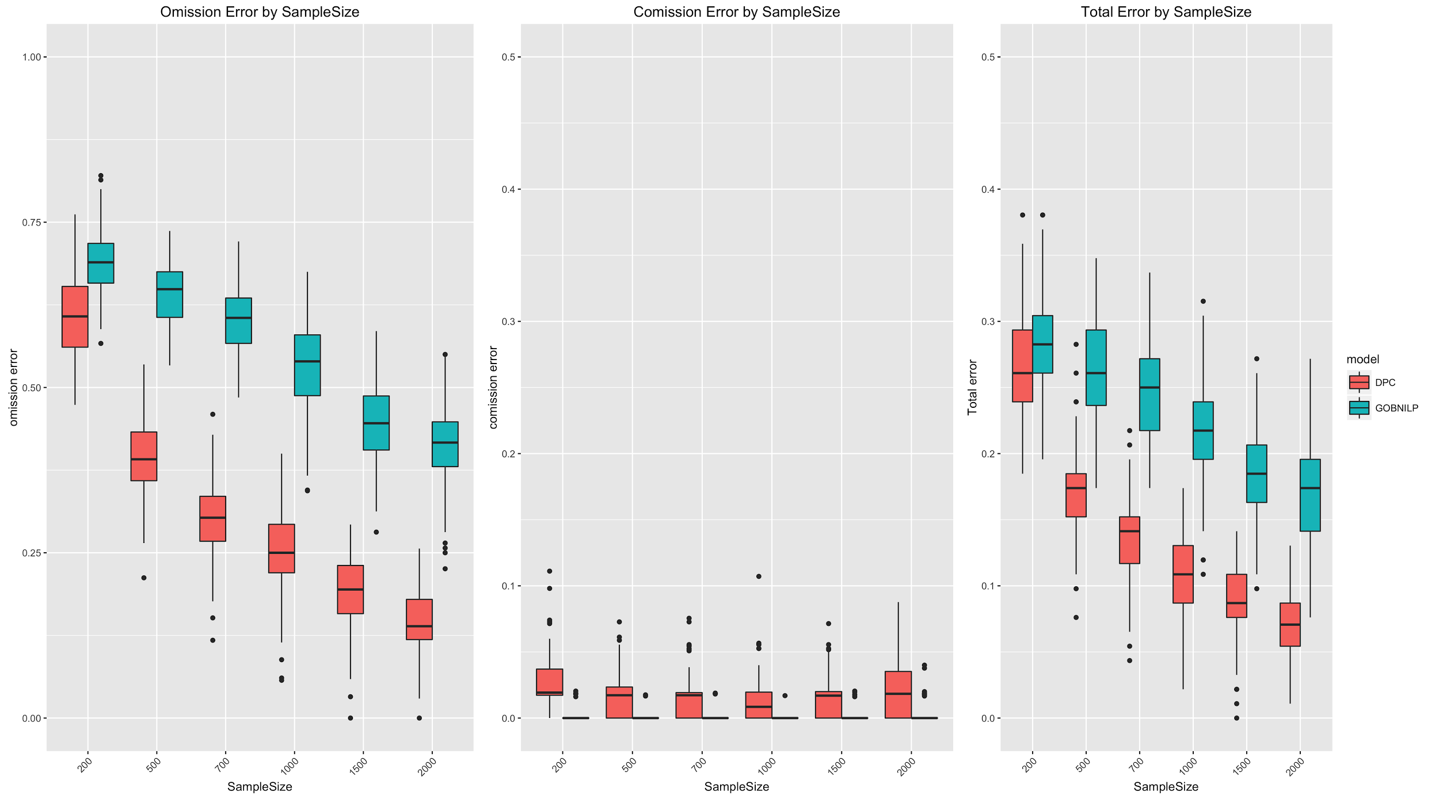
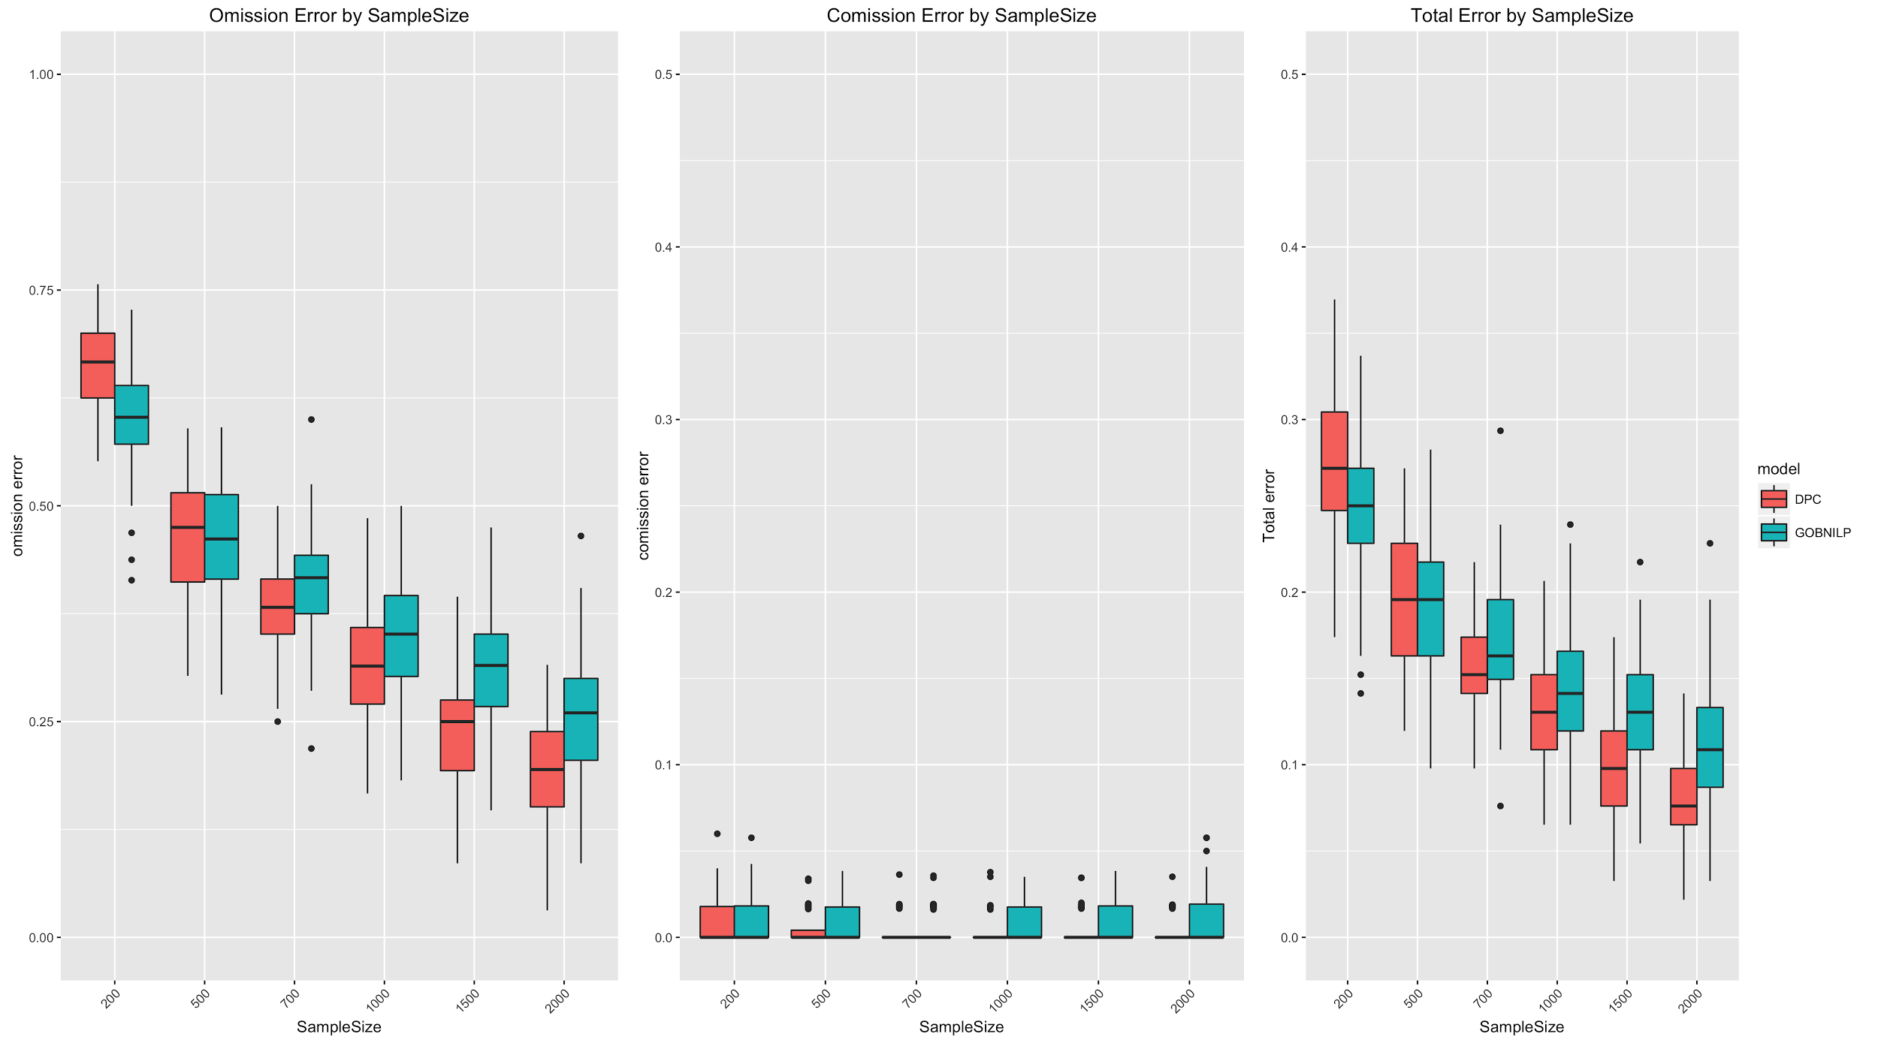
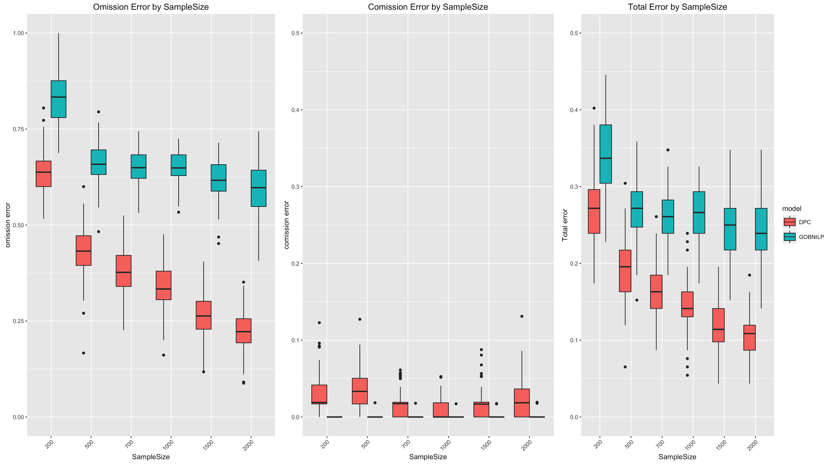
Sample Size for Discrete Data
8 Node 25% density graph

Slide 63



Urate for Discrete Data
6 node Graph, 35% density, 1000 effective Sample Size
Error increases substantially with Urate

Slide 64



Signal To Noise Ratio for Discrete Data
8 node 25% density graph
Greater effect to 2 arity variables

Slide 65
Future Research
G¹ errors
ranking edge certainty
Could Improve Hamming neighbor search
Quicker understanding of whether a G² graph is projectable to G¹
Would prevent needing hamming neighbor search
Can field experts choose best G¹ graph
Further understanding of equivalence classes
Provide Python Package for easy use

